Slide 1

Wireless Networking
Ambuj Varshney
ambujv@nus.edu.sg
Notes:
++ Thank you for inviting me to give this talk
++ In this talk, I will present a pathway that can enable us to make wireless embedded systems ubiquitous. I will describe my previous research efforts that tackle the critical challenges that limit the growth of wireless embedded systems. These are related to the growing energy asymmetry that exists between sensing, computation and communication blocks on these platforms.
++ Finally, I will conclude my talk by covering the research agenda that I would like to work on as a faculty member.

Slide 2
Administrative stuff

Slide 3
Revisiting dB, dBm, and dBi, and operations
Let us recall the definition of all three of them:
dB (Decibel):
Logarithmic unit for ratios (gain/loss).
Dimensionless (e.g., 3 dB amplifier gain).
dBm:
Absolute power referenced to 1 mW.
0 dBm = 1 mW (e.g., 20 dBm = 100 mW).
dBi:
Antenna gain relative to an isotropic radiator.
Measures directionality (e.g., 5 dBi = 5 dB over isotropic).

Slide 4
Combining antenna gains?
Question: You have two antennas each with an antenna gain of 5 dBi. What is the effective gain when they are used together in an array?

Slide 5
Combining antenna gains?
Question: Suppose you design a beamforming array using two different antennas: one has an 8 dBi gain and the other a 12 dBi gain. If both antennas are fed with the same signal and their outputs combine coherently (with proper phase alignment), what is the effective array gain?

Slide 6
Combining signals?
Question: A receiver has a dual-antenna MIMO system where each branch, after its processing, provides a signal level of -60 dBm. You wish to determine the total received power when these signals are combined coherently.

Slide 7
Received power calculations
A transmitter chain includes stages from baseband to antenna output:
• Transmitter output: 50 dBm
• Upconverter insertion loss: 7 dB
• RF amplifier gain: 20 dB
• Cable loss (between amplifier and antenna): 3 dB
• Antenna gain: 15 dBi
• Free-space path loss to a distant receiver: 120 dB

Slide 8
Example
A signal is transmitted from a source, relayed, and then delivered to the final destination. The link has two hops:
Hop 1 (Source to Relay): Tx Power: 35 dBm, Cable loss: 2 dB
Upconverter insertion loss: 4 dB, Antenna gain: 10 dBi,
Free-space path loss: 95 dB
Hop 2 (Relay to Final Destination): Relay amplifier gain: 20 dB, Cable loss: 1 dB, Relay antenna gain: 12 dBi, Free-space path loss: 98 dB, Final receiver antenna gain: 8 dBi, Downconverter insertion loss: 3 dB, Additional cable loss: 1 dB
What is final received signal strength?

Slide 9
When can we add quantities together?
Addition/Subtraction is Valid:
When you’re dealing with ratios (gains or losses), expressed in dB or dBi, you can add/subtract them directly because they represent multiplicative factors in the linear domain.
Addition is Not Direct for Absolute Powers (dBm):
dBm values are absolute measures of power. To combine independent power sources, convert to a linear scale (mW), perform the addition, and then convert back to dBm.
Understanding the Context is Crucial:
Always verify whether the decibel values represent absolute power levels or relative gains/losses before performing arithmetic operations.

Slide 10
Understanding Channel Capacity & Link Quality
Definition: Maximum rate at which information can be transmitted over a communication channel without error
Channel capacity is measured in the unit of bits/second
How does channel capacity relate to the link quality?
Higher SNR usually leads to a higher capacity
Recall bandwidth is the frequency range over which the signal is transmitted; a wider bandwidth can support higher data rates
Factors that reduce link quality? Fading, interference, reduce channel capacity
Takeaways:
Good link quality (high SNR, low interference) improves channel capacity
Poor link quality leads to lower achievable data rates, even if the theoretical channel capacity is high

Slide 11
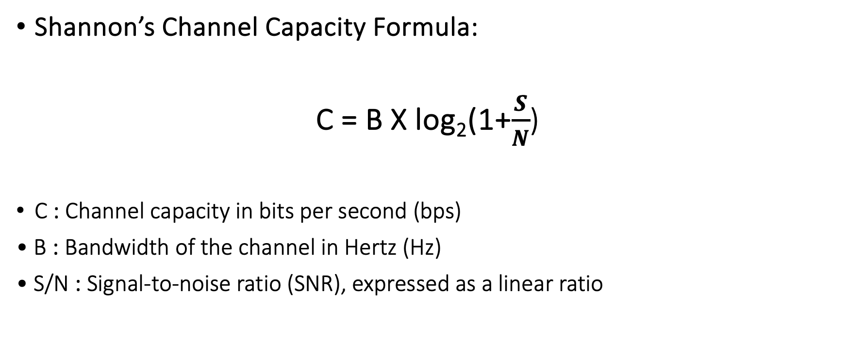
Channel Capacity & Link Quality – The Shannon Perspective
Shannon’s Channel Capacity Formula:
C = B X log₂(1+$\frac{S}{N}$)
C : Channel capacity in bits per second (bps)
• B : Bandwidth of the channel in Hertz (Hz)
• S/N : Signal-to-noise ratio (SNR), expressed as a linear ratio

Slide 12
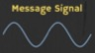
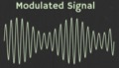

How are radio waves modified to carry information
Encoding information “baseband" in an analog “carrier” signal
Baseband signal often much lower in frequency than the carrier
Frequency of the carrier signal dictates the part of the radio spectrum
Why? baseband signals or information change is at much lower rate
Speech: upto 20 KHz, temperature changes – few Hz
Enables a better usage of the radio spectrum
Enables communication among several devices sharing the spectrum
Modulation
Notes:
First, we look at the computational elements, and these consist of a microcontroller or an FPGA. Today, we find that these computational elements consume at least one order of magnitude higher power consumption when compared to the commonly used sensors.
However, we also find that microcontrollers are increasingly becoming energy efficient. We investigate a typical microcontroller that has been used in sensor platforms over the past two decades. We find that energy efficiency has improved by almost two orders of magnitude. Some of the present-generation microcontrollers, such as Ambiq Apollo4 consume just 3 uA/MHz than 330 uA for MSP430 used on platforms such as TelOS B.
If the trend continues, we can expect the microcontrollers to catch up with the sensors and become energy-efficient. This significant improvement is that the digital components are increasing becoming efficient as they follow moore’s law.

Slide 13
What are different modulation techniques?
Vary frequency, amplitude, phase of carrier signal according message signal
We can also vary them together to support complex modulation schemes
Analog and Digital counterparts of these modulation schemes exist
Modulation
Notes:
First, we look at the computational elements, and these consist of a microcontroller or an FPGA. Today, we find that these computational elements consume at least one order of magnitude higher power consumption when compared to the commonly used sensors.
However, we also find that microcontrollers are increasingly becoming energy efficient. We investigate a typical microcontroller that has been used in sensor platforms over the past two decades. We find that energy efficiency has improved by almost two orders of magnitude. Some of the present-generation microcontrollers, such as Ambiq Apollo4 consume just 3 uA/MHz than 330 uA for MSP430 used on platforms such as TelOS B.
If the trend continues, we can expect the microcontrollers to catch up with the sensors and become energy-efficient. This significant improvement is that the digital components are increasing becoming efficient as they follow moore’s law.

Slide 14
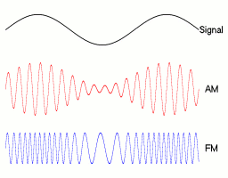
Amplitude modulation: vary amplitude of carrier signal
Change amplitude of a carrier signal according to the message signal
Simplest and the earliest modulation technique
Remains widely used for radio broadcast, also computer communication
Notes:
First, we look at the computational elements, and these consist of a microcontroller or an FPGA. Today, we find that these computational elements consume at least one order of magnitude higher power consumption when compared to the commonly used sensors.
However, we also find that microcontrollers are increasingly becoming energy efficient. We investigate a typical microcontroller that has been used in sensor platforms over the past two decades. We find that energy efficiency has improved by almost two orders of magnitude. Some of the present-generation microcontrollers, such as Ambiq Apollo4 consume just 3 uA/MHz than 330 uA for MSP430 used on platforms such as TelOS B.
If the trend continues, we can expect the microcontrollers to catch up with the sensors and become energy-efficient. This significant improvement is that the digital components are increasing becoming efficient as they follow moore’s law.

Slide 15
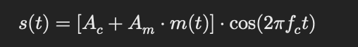
Amplitude modulation: vary amplitude of carrier signal
A_{c} = Carrier amplitude
A_{m} = Modulating (baseband) signal amplitude
m(t) = Message signal
f_{c} = Carrier frequency

Slide 16
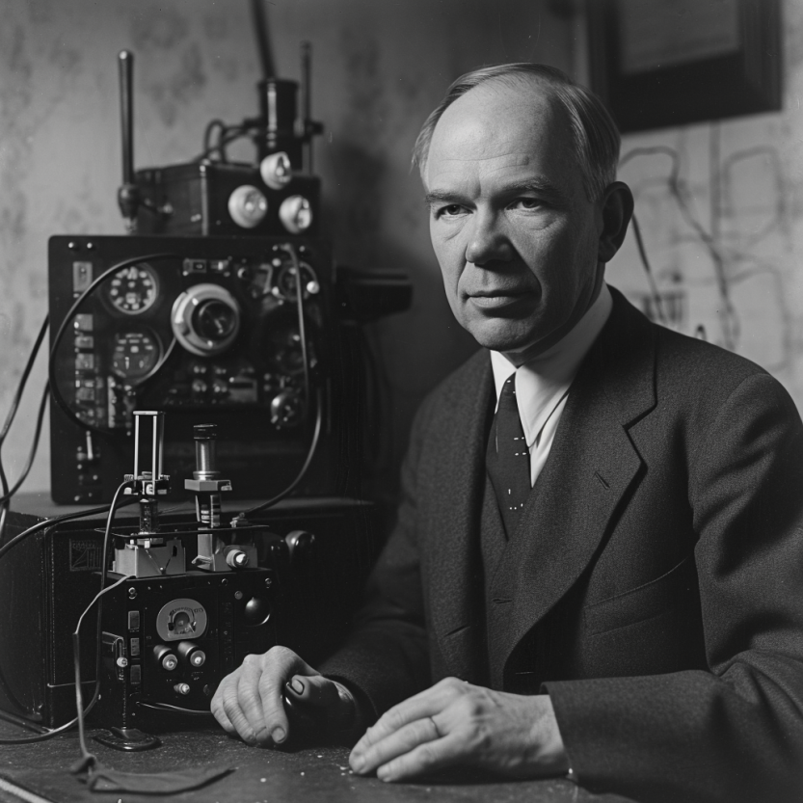
Frequency modulation: vary frequency of carrier signal
Change frequency of a carrier signal according to the message signal
Advantages (over AM): Resilient to interference, spectrum efficiency
Remains widely used for radio broadcast, also computer communication
First demonstrated by Armstrong in 1935!
Notes:
First, we look at the computational elements, and these consist of a microcontroller or an FPGA. Today, we find that these computational elements consume at least one order of magnitude higher power consumption when compared to the commonly used sensors.
However, we also find that microcontrollers are increasingly becoming energy efficient. We investigate a typical microcontroller that has been used in sensor platforms over the past two decades. We find that energy efficiency has improved by almost two orders of magnitude. Some of the present-generation microcontrollers, such as Ambiq Apollo4 consume just 3 uA/MHz than 330 uA for MSP430 used on platforms such as TelOS B.
If the trend continues, we can expect the microcontrollers to catch up with the sensors and become energy-efficient. This significant improvement is that the digital components are increasing becoming efficient as they follow moore’s law.

Slide 17
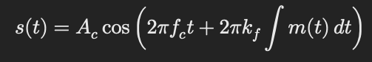
Frequency modulation: vary frequency of carrier signal
A_{c} = Carrier amplitude
f_{c} = Carrier frequency
k_{f} = Frequency sensitivity of the modulator (how much the carrier frequency changes in response to the amplitude of the modulating signal)
m(t) = Modulating signal
Notes:
First, we look at the computational elements, and these consist of a microcontroller or an FPGA. Today, we find that these computational elements consume at least one order of magnitude higher power consumption when compared to the commonly used sensors.
However, we also find that microcontrollers are increasingly becoming energy efficient. We investigate a typical microcontroller that has been used in sensor platforms over the past two decades. We find that energy efficiency has improved by almost two orders of magnitude. Some of the present-generation microcontrollers, such as Ambiq Apollo4 consume just 3 uA/MHz than 330 uA for MSP430 used on platforms such as TelOS B.
If the trend continues, we can expect the microcontrollers to catch up with the sensors and become energy-efficient. This significant improvement is that the digital components are increasing becoming efficient as they follow moore’s law.

Slide 18
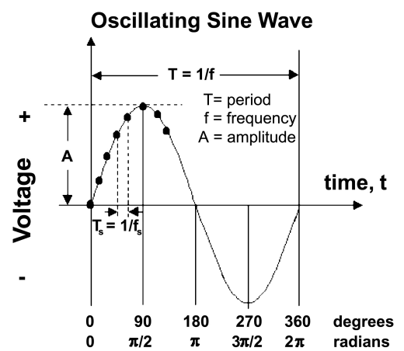
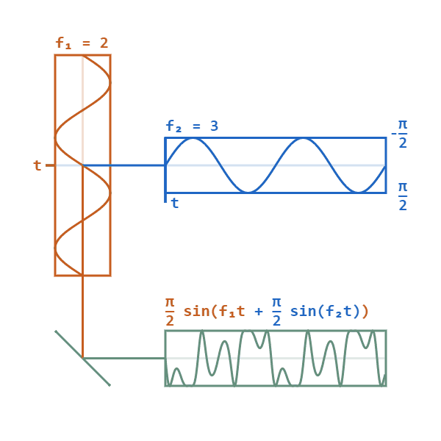
Phase modulation: vary phase of carrier signal
Change phase of a carrier signal according to the message signal
It is an integral part of modern communication standards: WiFi, Television
Advantages (over FM): Better SNR, spectral efficiency
Notes:
First, we look at the computational elements, and these consist of a microcontroller or an FPGA. Today, we find that these computational elements consume at least one order of magnitude higher power consumption when compared to the commonly used sensors.
However, we also find that microcontrollers are increasingly becoming energy efficient. We investigate a typical microcontroller that has been used in sensor platforms over the past two decades. We find that energy efficiency has improved by almost two orders of magnitude. Some of the present-generation microcontrollers, such as Ambiq Apollo4 consume just 3 uA/MHz than 330 uA for MSP430 used on platforms such as TelOS B.
If the trend continues, we can expect the microcontrollers to catch up with the sensors and become energy-efficient. This significant improvement is that the digital components are increasing becoming efficient as they follow moore’s law.

Slide 19
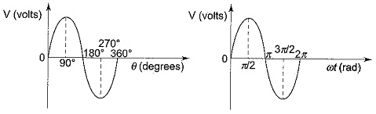
What is phase of a sinusoidal signal?
Phase represents position of point on the waveform cycle
It represents an offset from the starting position of the sine wave
Measured in the unit of radian or degrees
Complete cycle of sine wave is 360 degrees or 2pi radian
Notes:
First, we look at the computational elements, and these consist of a microcontroller or an FPGA. Today, we find that these computational elements consume at least one order of magnitude higher power consumption when compared to the commonly used sensors.
However, we also find that microcontrollers are increasingly becoming energy efficient. We investigate a typical microcontroller that has been used in sensor platforms over the past two decades. We find that energy efficiency has improved by almost two orders of magnitude. Some of the present-generation microcontrollers, such as Ambiq Apollo4 consume just 3 uA/MHz than 330 uA for MSP430 used on platforms such as TelOS B.
If the trend continues, we can expect the microcontrollers to catch up with the sensors and become energy-efficient. This significant improvement is that the digital components are increasing becoming efficient as they follow moore’s law.

Slide 20
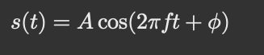
Mathematical representation of the phase
A: Amplitude of the signal
f: Frequency of the signal
phi: Phase (phase constant or offset)
The phase phi determines where in its cycle the wave is (begins at t=0)
Notes:
First, we look at the computational elements, and these consist of a microcontroller or an FPGA. Today, we find that these computational elements consume at least one order of magnitude higher power consumption when compared to the commonly used sensors.
However, we also find that microcontrollers are increasingly becoming energy efficient. We investigate a typical microcontroller that has been used in sensor platforms over the past two decades. We find that energy efficiency has improved by almost two orders of magnitude. Some of the present-generation microcontrollers, such as Ambiq Apollo4 consume just 3 uA/MHz than 330 uA for MSP430 used on platforms such as TelOS B.
If the trend continues, we can expect the microcontrollers to catch up with the sensors and become energy-efficient. This significant improvement is that the digital components are increasing becoming efficient as they follow moore’s law.

Slide 21
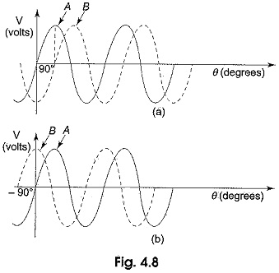
Mathematical representation of the phase
Changing phi shifts the waveform left or right in time
Notes:
First, we look at the computational elements, and these consist of a microcontroller or an FPGA. Today, we find that these computational elements consume at least one order of magnitude higher power consumption when compared to the commonly used sensors.
However, we also find that microcontrollers are increasingly becoming energy efficient. We investigate a typical microcontroller that has been used in sensor platforms over the past two decades. We find that energy efficiency has improved by almost two orders of magnitude. Some of the present-generation microcontrollers, such as Ambiq Apollo4 consume just 3 uA/MHz than 330 uA for MSP430 used on platforms such as TelOS B.
If the trend continues, we can expect the microcontrollers to catch up with the sensors and become energy-efficient. This significant improvement is that the digital components are increasing becoming efficient as they follow moore’s law.

Slide 22
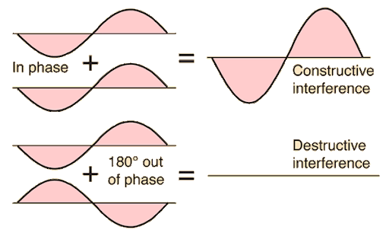
Impact of phase shifts on waves (summation)
Phase shift occurs when the phase of a wave is advanced or delayed
Constructive Interference: When two waves with the same phase add together to form a larger amplitude.
Destructive Interference: When two waves are out-of-phase (e.g., 180° apart) and cancel each other.
Notes:
First, we look at the computational elements, and these consist of a microcontroller or an FPGA. Today, we find that these computational elements consume at least one order of magnitude higher power consumption when compared to the commonly used sensors.
However, we also find that microcontrollers are increasingly becoming energy efficient. We investigate a typical microcontroller that has been used in sensor platforms over the past two decades. We find that energy efficiency has improved by almost two orders of magnitude. Some of the present-generation microcontrollers, such as Ambiq Apollo4 consume just 3 uA/MHz than 330 uA for MSP430 used on platforms such as TelOS B.
If the trend continues, we can expect the microcontrollers to catch up with the sensors and become energy-efficient. This significant improvement is that the digital components are increasing becoming efficient as they follow moore’s law.

Slide 23
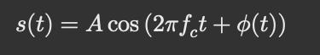
Phase based modulation scheme
Uses different phase shifts to represent digital data
Phase carries critical timing and synchronization information and Small phase changes can represent significant data in digital communications
The instantaneous phase phi of the carrier is altered by modulating signal
Notes:
First, we look at the computational elements, and these consist of a microcontroller or an FPGA. Today, we find that these computational elements consume at least one order of magnitude higher power consumption when compared to the commonly used sensors.
However, we also find that microcontrollers are increasingly becoming energy efficient. We investigate a typical microcontroller that has been used in sensor platforms over the past two decades. We find that energy efficiency has improved by almost two orders of magnitude. Some of the present-generation microcontrollers, such as Ambiq Apollo4 consume just 3 uA/MHz than 330 uA for MSP430 used on platforms such as TelOS B.
If the trend continues, we can expect the microcontrollers to catch up with the sensors and become energy-efficient. This significant improvement is that the digital components are increasing becoming efficient as they follow moore’s law.

Slide 24
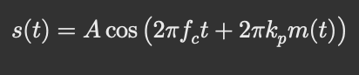
Phase modulation scheme
• A : Amplitude of the carrier
• fc : Carrier frequency
• kp : Phase sensitivity (radians per unit amplitude)
• m(t) : Modulating signal
Notes:
First, we look at the computational elements, and these consist of a microcontroller or an FPGA. Today, we find that these computational elements consume at least one order of magnitude higher power consumption when compared to the commonly used sensors.
However, we also find that microcontrollers are increasingly becoming energy efficient. We investigate a typical microcontroller that has been used in sensor platforms over the past two decades. We find that energy efficiency has improved by almost two orders of magnitude. Some of the present-generation microcontrollers, such as Ambiq Apollo4 consume just 3 uA/MHz than 330 uA for MSP430 used on platforms such as TelOS B.
If the trend continues, we can expect the microcontrollers to catch up with the sensors and become energy-efficient. This significant improvement is that the digital components are increasing becoming efficient as they follow moore’s law.

Slide 25
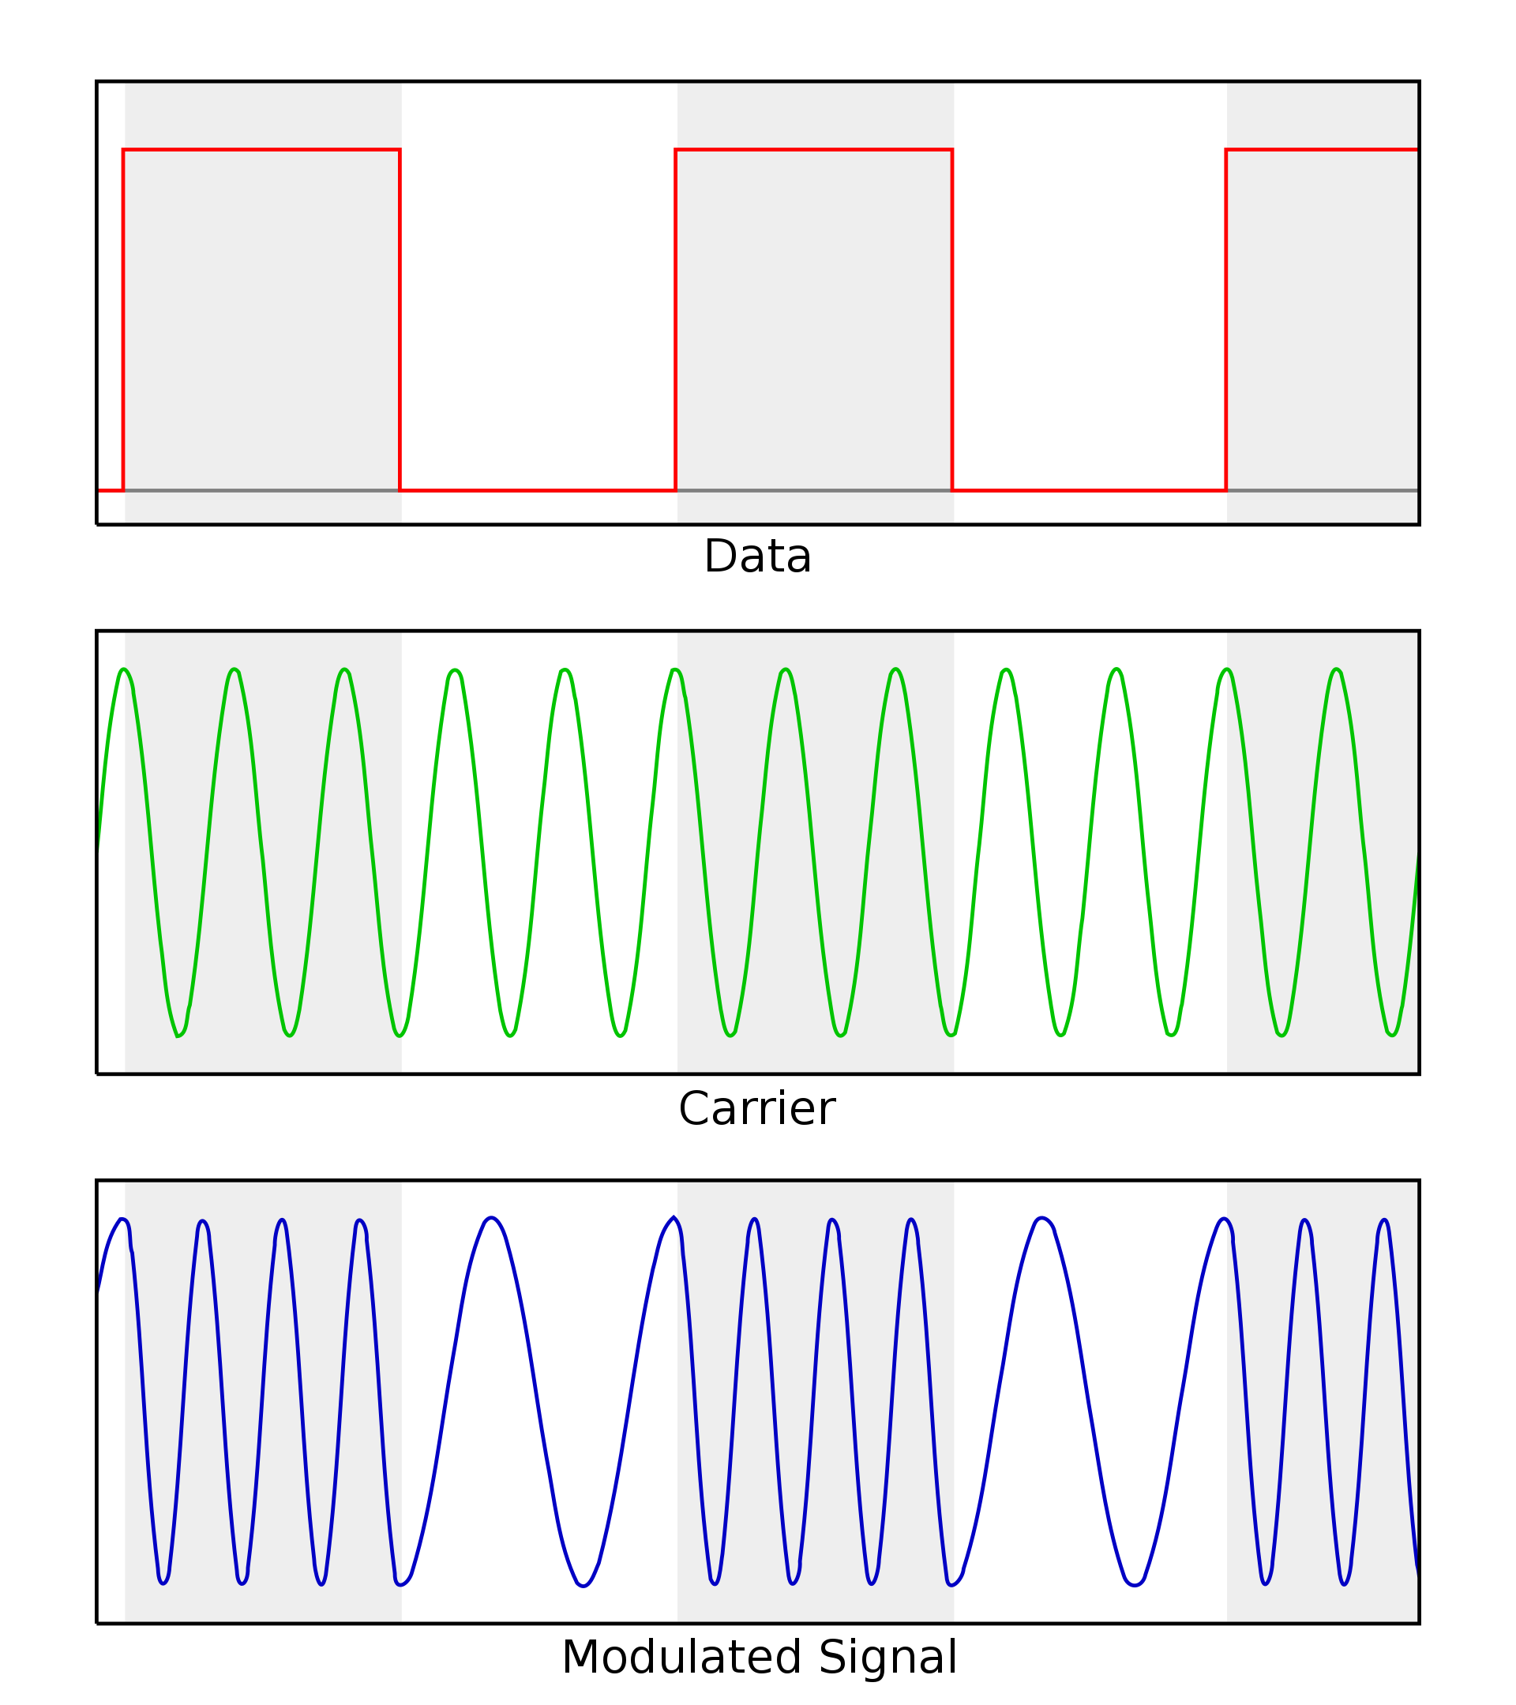
Digital equivalent of the AM, FM and PM modulation
Digital variant of these schemes vary analog signal according to digital bits
ASK: amplitude shift keying
FSK: frequency shift keying
PSK: phase shift keying
Digital variants relevant when we talk about computer communication
Notes:
First, we look at the computational elements, and these consist of a microcontroller or an FPGA. Today, we find that these computational elements consume at least one order of magnitude higher power consumption when compared to the commonly used sensors.
However, we also find that microcontrollers are increasingly becoming energy efficient. We investigate a typical microcontroller that has been used in sensor platforms over the past two decades. We find that energy efficiency has improved by almost two orders of magnitude. Some of the present-generation microcontrollers, such as Ambiq Apollo4 consume just 3 uA/MHz than 330 uA for MSP430 used on platforms such as TelOS B.
If the trend continues, we can expect the microcontrollers to catch up with the sensors and become energy-efficient. This significant improvement is that the digital components are increasing becoming efficient as they follow moore’s law.

Slide 26
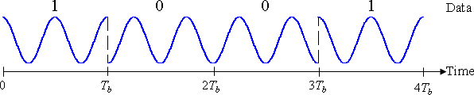
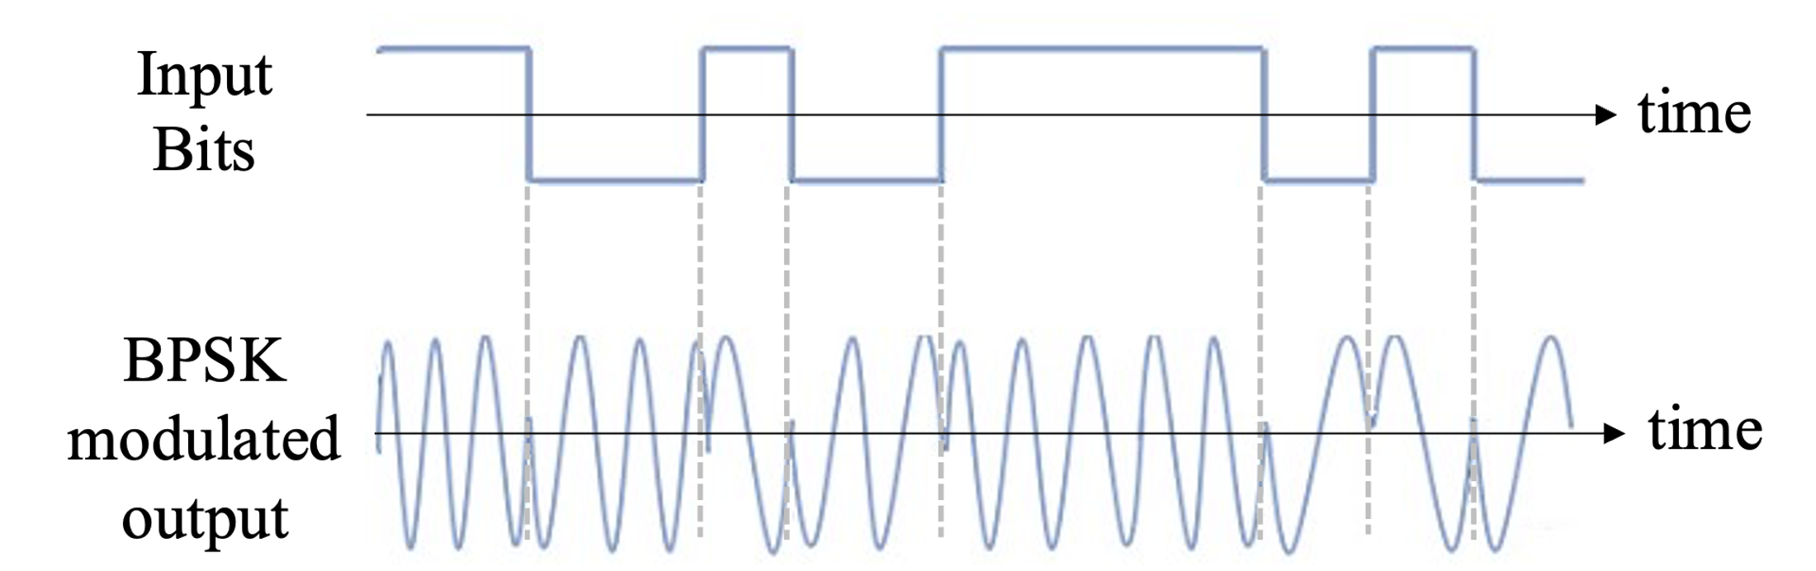
Binary Phase Shift Keying
BPSK is a simple form of phase modulation where the phase is shifted between two values, which is Bit 0 and Bit 1
Bit ‘0’ → Phase 0 degrees (ASin(2*pi*f_{c}t))
Bit ‘1’ → Phase 180 degrees or pi (ASin(2*pi*f_{c}t + pi))
Notes:
First, we look at the computational elements, and these consist of a microcontroller or an FPGA. Today, we find that these computational elements consume at least one order of magnitude higher power consumption when compared to the commonly used sensors.
However, we also find that microcontrollers are increasingly becoming energy efficient. We investigate a typical microcontroller that has been used in sensor platforms over the past two decades. We find that energy efficiency has improved by almost two orders of magnitude. Some of the present-generation microcontrollers, such as Ambiq Apollo4 consume just 3 uA/MHz than 330 uA for MSP430 used on platforms such as TelOS B.
If the trend continues, we can expect the microcontrollers to catch up with the sensors and become energy-efficient. This significant improvement is that the digital components are increasing becoming efficient as they follow moore’s law.

Slide 27
Quadrature Binary Phase Shift Keying
QPSK extends BPSK by using four distinct phase states, allowing the encoding of 2 bits per symbol
Bit ‘00’ → Phase 45 degrees (ASin(2*pi*f_{c}t + pi/8))
Bit ‘01’ → Phase 90 degrees (ASin(2*pi*f_{c}t + pi/4))
Bit ‘11’ → Phase 135 degrees
Bit ‘10’ → Phase 225 degrees
What is advantage over BPSK?
Notes:
First, we look at the computational elements, and these consist of a microcontroller or an FPGA. Today, we find that these computational elements consume at least one order of magnitude higher power consumption when compared to the commonly used sensors.
However, we also find that microcontrollers are increasingly becoming energy efficient. We investigate a typical microcontroller that has been used in sensor platforms over the past two decades. We find that energy efficiency has improved by almost two orders of magnitude. Some of the present-generation microcontrollers, such as Ambiq Apollo4 consume just 3 uA/MHz than 330 uA for MSP430 used on platforms such as TelOS B.
If the trend continues, we can expect the microcontrollers to catch up with the sensors and become energy-efficient. This significant improvement is that the digital components are increasing becoming efficient as they follow moore’s law.

Slide 28
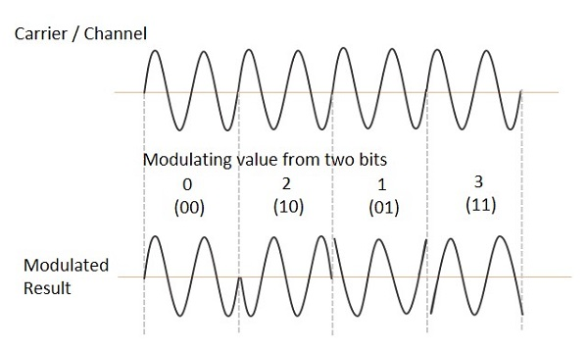
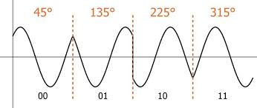
Quadrature Binary Phase Shift Keying
QPSK extends BPSK by using four distinct phase states, allowing the encoding of 2 bits per symbol
Bit ‘00’ → Phase 45 degrees (ASin(2*pi*f_{c}t + pi/8))
Bit ‘01’ → Phase 90 degrees (ASin(2*pi*f_{c}t + pi/4))
Bit ‘11’ → Phase 135 degrees
Bit ‘10’ → Phase 225 degrees
What is advantage over BPSK? Doubles the bit rate for the same bandwidth
Notes:
First, we look at the computational elements, and these consist of a microcontroller or an FPGA. Today, we find that these computational elements consume at least one order of magnitude higher power consumption when compared to the commonly used sensors.
However, we also find that microcontrollers are increasingly becoming energy efficient. We investigate a typical microcontroller that has been used in sensor platforms over the past two decades. We find that energy efficiency has improved by almost two orders of magnitude. Some of the present-generation microcontrollers, such as Ambiq Apollo4 consume just 3 uA/MHz than 330 uA for MSP430 used on platforms such as TelOS B.
If the trend continues, we can expect the microcontrollers to catch up with the sensors and become energy-efficient. This significant improvement is that the digital components are increasing becoming efficient as they follow moore’s law.

Slide 29
Example
Question: You want to transmit bitstream 1 0 11 using BPSK. What are the waveforms being transmitted?

Slide 30
Example
Question: You want to transmit bitstream 00111010 using QPSK. What are the waveforms being transmitted?

Slide 31
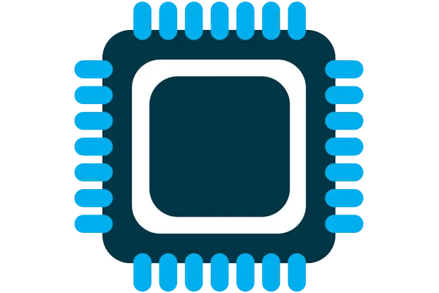



What are components of internet of things
Computation and Storage
Sensing and Actuation
Power
Wireless Connectivity
Notes:
First, we look at the computational elements, and these consist of a microcontroller or an FPGA. Today, we find that these computational elements consume at least one order of magnitude higher power consumption when compared to the commonly used sensors.
However, we also find that microcontrollers are increasingly becoming energy efficient. We investigate a typical microcontroller that has been used in sensor platforms over the past two decades. We find that energy efficiency has improved by almost two orders of magnitude. Some of the present-generation microcontrollers, such as Ambiq Apollo4 consume just 3 uA/MHz than 330 uA for MSP430 used on platforms such as TelOS B.
If the trend continues, we can expect the microcontrollers to catch up with the sensors and become energy-efficient. This significant improvement is that the digital components are increasing becoming efficient as they follow moore’s law.

Slide 32
Microcontrollers are heart of embedded systems
A microcontroller (µC) is a small computer on a single integrated circuit consisting of a relatively simple central processing unit (CPU) combined with peripheral devices such as memories, I/O devices, and timers
More than half of all CPUs sold are microcontroller (and growing)
Low-power, often includes sleep mode that dramatically reduces the power consumed to micro or even nanowatts
Notes:
Backscatter communication actually help us overcome this limitation

Slide 33
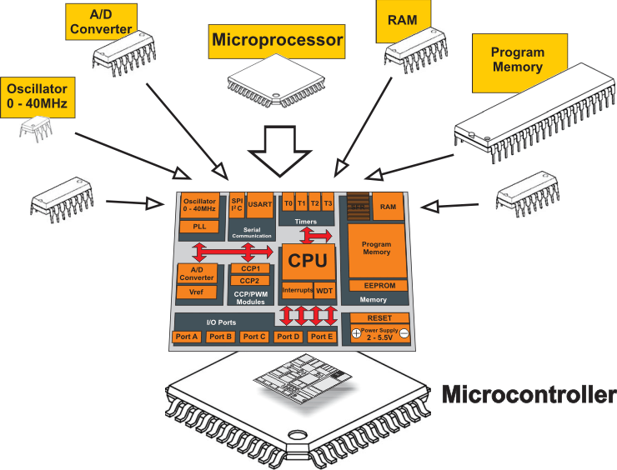
What is a microcontroller? Microprocessor + Peripherals + Memory + Pins + ?
Microcontroller
Processor
Peripherals
Pins
Memory
Notes:
Backscatter communication actually help us overcome this limitation

Slide 34
Instruction set architecture and realization
Instruction set architecture (ISA): It is the definition of the instructions that the processor can execute and certain structural constraints (such as word size) that realizations must share.
Processor, Realization, Chip: Piece of silicon sold by a vendor which is the realization of the ISA.
A ISA may appear in many different chips, often made by different manufacturers, and often having widely varying performance profiles.
Advantages?

Slide 35
Instruction set architecture and realization
Instruction set architecture (ISA): It is the definition of the instructions that the processor can execute and certain structural constraints (such as word size) that realizations must share.
Processor, Realization, Chip: Piece of silicon sold by a vendor which is the realization of the ISA.
A ISA may appear in many different chips, often made by different manufacturers, and often having widely varying performance profiles.
Advantages? Sharing an ISA in a family of processors is that software tools, which are costly to develop, may be shared, and (sometimes) the same programs may run correctly on multiple realizations.

Slide 36
Other embedded microcontroller architectures
Motorola 6800
Intel 8080
Intel 8051
Atmel AVR
ARM
Motorola Coldfire
MIPS
PowerPC
............

Slide 37
Digital Signal Processor
Many embedded applications require performing of signal processing. Can you think of some embedded applications?
Characteristics of application requiring signal processing:
Deal with large amounts of information
Sample in time, space or both
Sophisticated mathematical operations like filtering, frequency analysis
Digital signal processor are class of processors optimized for such mathematically intensive tasks

Slide 38
Memory on microcontroller (hierarchy)
Registers
RAM
ROM

Slide 39
Random access memory (SRAM and DRAM)
Provides fast, temporary storage where individual bytes or words can be read or written quickly
SRAM (Static RAM):
Faster and more reliable
Uses more silicon area per bit
Data remains as long as power is maintained
DRAM (Dynamic RAM):
Uses less area per bit (higher density)
Requires periodic refresh cycles to maintain data
Refresh cycles can introduce access time variability and potential stalling
Important: Program execution time may vary based on whether memory accesses hit SRAM or DRAM

Slide 40
Non-volatile memory
Retains data even when power is lost; essential for firmware and persistent user data
ROM (Read-Only Memory / Mask ROM)
Fixed content programmed during manufacturing
Suitable for mass-produced firmware that does not change
EEPROM (Electrically-Erasable Programmable ROM)
Can be reprogrammed in the field
Longer write times and limited write cycles

Slide 41
Non-volatile memory
Flash Memory:
NOR Flash:
• Accessible like RAM but slower for writes/erases
NAND Flash:
Cheaper, faster erase/write times
Data is accessed in large blocks (hundreds to thousands of bits)
• Disk Memories:
Provide very large capacities.
Involve mechanical parts (e.g., spinning disks), leading to slower and variable access times

Slide 42
Example of non-volatile memory: Flash
Same design as SSDs and Flash drives
Memory is stored with no energy costs
Reading is lowish energy and quick
Writing is high energy and very slow
Writing also has to occur in blocks (e.g. 512 bytes)
Concern: Flash has a limited lifetime ~10,000 writes
Only writing to Flash when you load code? Essentially forever
Recording data to Flash every second? 2.8 hours

Slide 43
SRAM (RAM) versus Flash (ROM)
Size and time difference between non-volatile and volatile memory is significantly reduced from traditional computing
Non-volatile store 2-10x larger than volatile
Single-cycle RAM. Maybe two-cycles to Flash (to read)
Major difference: energy and writability
SRAM is low-energy to read and write (no refresh needed)
Flash is lowish-energy to read, but very high energy to write
Hierarchical structure is not enforced
Same address space for RAM and Flash (very different from traditional)
Run instructions right inside of Flash
Keep variables in RAM (or const variables in Flash)

Slide 44
Memory Map
A memory map defines how processor addresses correspond to physical memory and the peripherals
The size of memory map is constrained by the processors address width. A 32 bit processor? How many locations?

Slide 45
Memory Map
A memory map defines how processor addresses correspond to physical memory and the peripherals
The size of memory map is constrained by the processors address width. A 32 bit processor? How many locations?
2³² locations or 4 Gigabytes of memory is accessible
Example (ARM Cortex-M3)
Separation of Address Spaces: Distinct regions for program memory (flash), data memory (SRAM, DRAM), and peripheral devices.
Harvard Architecture: Separates instructions (program memory) from data (data memory) to allow simultaneous fetches, improving throughput.

Slide 46
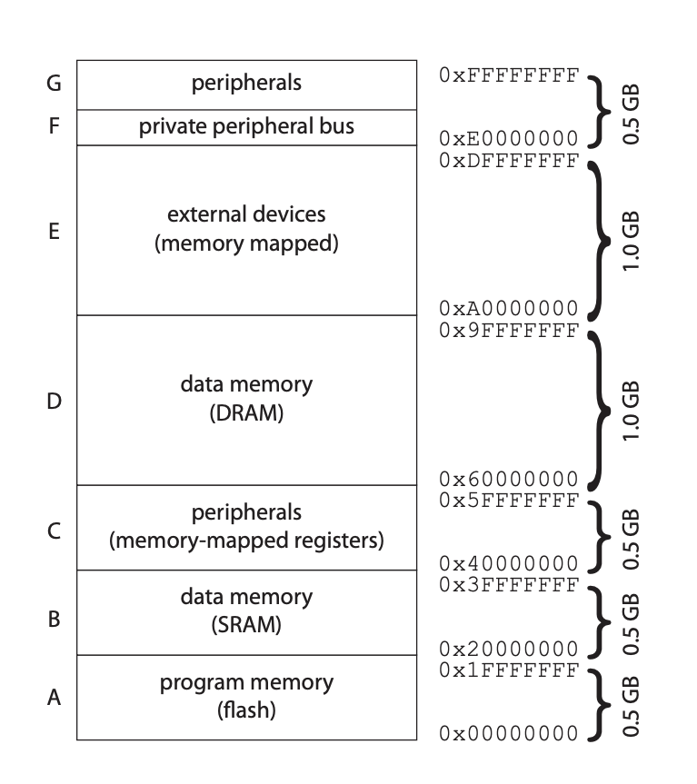
Memory Map

Slide 47
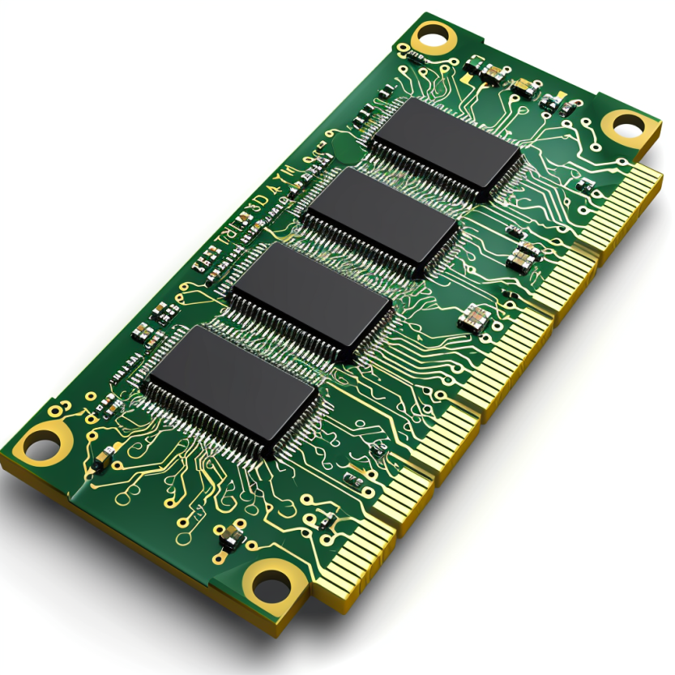
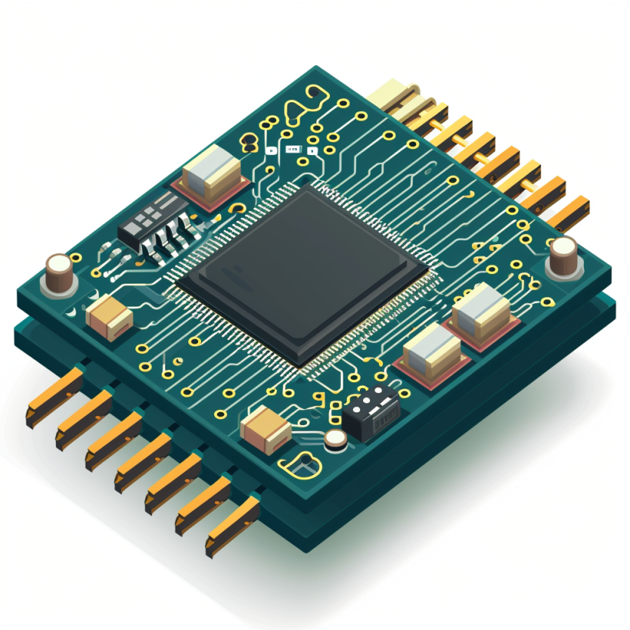
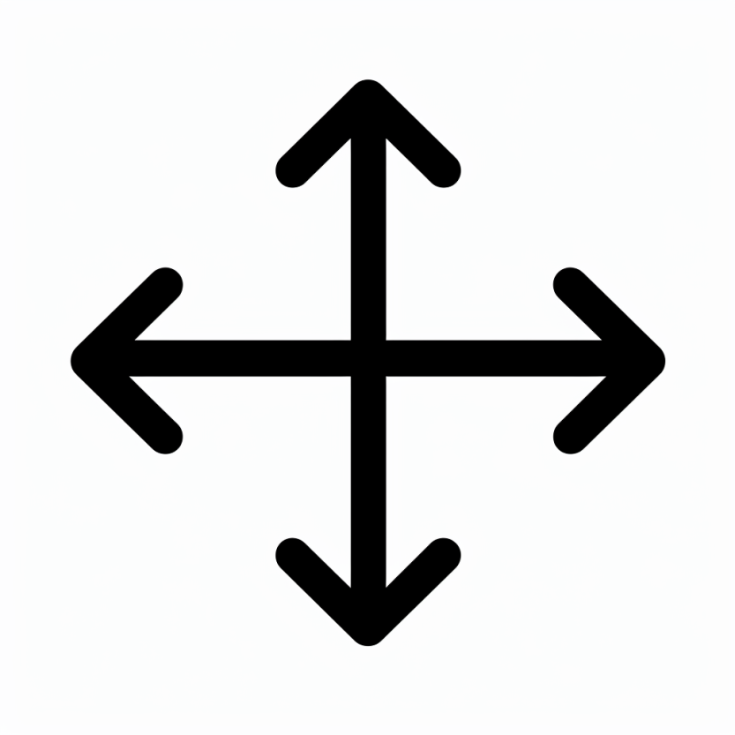



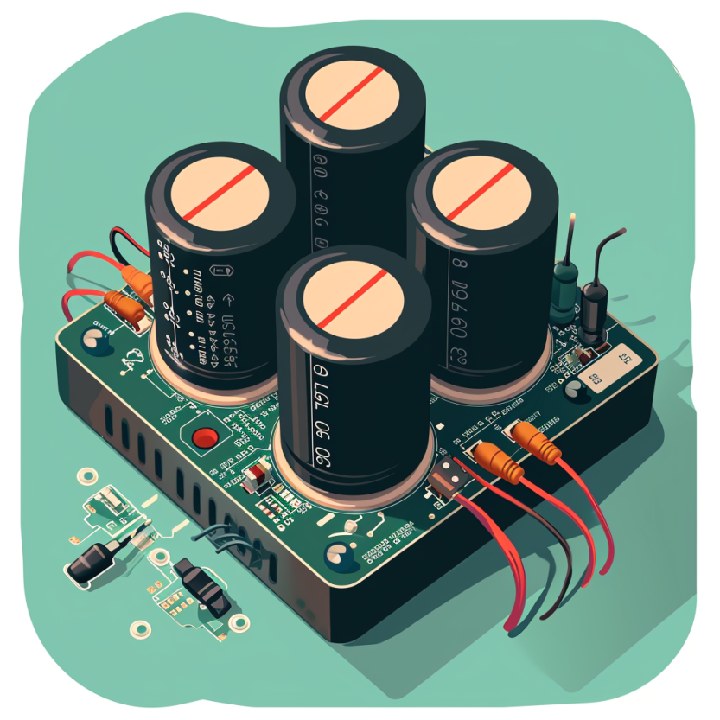
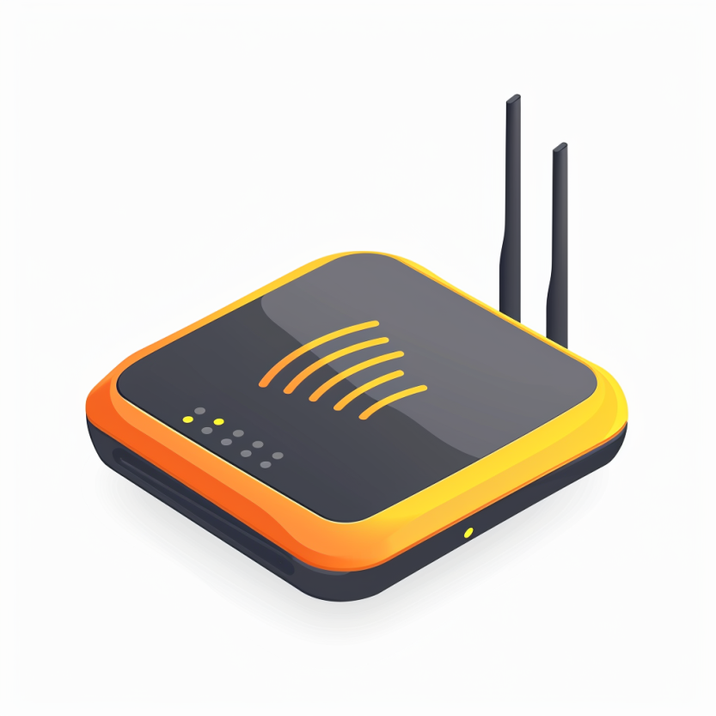

Four main tasks performed by an embedded device
Computation and Storage
Sensing and Actuation
Power
Management
Wireless Networking
Notes:
First, we look at the computational elements, and these consist of a microcontroller or an FPGA. Today, we find that these computational elements consume at least one order of magnitude higher power consumption when compared to the commonly used sensors.
However, we also find that microcontrollers are increasingly becoming energy efficient. We investigate a typical microcontroller that has been used in sensor platforms over the past two decades. We find that energy efficiency has improved by almost two orders of magnitude. Some of the present-generation microcontrollers, such as Ambiq Apollo4 consume just 3 uA/MHz than 330 uA for MSP430 used on platforms such as TelOS B.
If the trend continues, we can expect the microcontrollers to catch up with the sensors and become energy-efficient. This significant improvement is that the digital components are increasing becoming efficient as they follow moore’s law.

Slide 48
Sensors and Actuators bridges the digital world with the physical world
What are some examples of sensors?
What are examples of actuators?
Notes:
First, we look at the computational elements, and these consist of a microcontroller or an FPGA. Today, we find that these computational elements consume at least one order of magnitude higher power consumption when compared to the commonly used sensors.
However, we also find that microcontrollers are increasingly becoming energy efficient. We investigate a typical microcontroller that has been used in sensor platforms over the past two decades. We find that energy efficiency has improved by almost two orders of magnitude. Some of the present-generation microcontrollers, such as Ambiq Apollo4 consume just 3 uA/MHz than 330 uA for MSP430 used on platforms such as TelOS B.
If the trend continues, we can expect the microcontrollers to catch up with the sensors and become energy-efficient. This significant improvement is that the digital components are increasing becoming efficient as they follow moore’s law.

Slide 49
Sensors and Actuators bridges the digital world with the physical world
What are some examples of sensors?
Cameras, Accelerometers, Gyroscopes, Strain gauges, Microphones, Magnetometers, Radar, Lidar, Chemical sensors, Pressure sensors, Switches
What are examples of actuators?
Notes:
First, we look at the computational elements, and these consist of a microcontroller or an FPGA. Today, we find that these computational elements consume at least one order of magnitude higher power consumption when compared to the commonly used sensors.
However, we also find that microcontrollers are increasingly becoming energy efficient. We investigate a typical microcontroller that has been used in sensor platforms over the past two decades. We find that energy efficiency has improved by almost two orders of magnitude. Some of the present-generation microcontrollers, such as Ambiq Apollo4 consume just 3 uA/MHz than 330 uA for MSP430 used on platforms such as TelOS B.
If the trend continues, we can expect the microcontrollers to catch up with the sensors and become energy-efficient. This significant improvement is that the digital components are increasing becoming efficient as they follow moore’s law.

Slide 50
Sensors and Actuators bridges the digital world with the physical world
What are some examples of sensors?
Cameras, Accelerometers, Gyroscopes, Strain gauges, Microphones, Magnetometers, Radar, Lidar, Chemical sensors, Pressure sensors, Switches
What are examples of actuators?
Motor controllers, Solenoids, LEDs, lasers, LCD and plasma displays, Loudspeakers, Switches and Valves
Notes:
First, we look at the computational elements, and these consist of a microcontroller or an FPGA. Today, we find that these computational elements consume at least one order of magnitude higher power consumption when compared to the commonly used sensors.
However, we also find that microcontrollers are increasingly becoming energy efficient. We investigate a typical microcontroller that has been used in sensor platforms over the past two decades. We find that energy efficiency has improved by almost two orders of magnitude. Some of the present-generation microcontrollers, such as Ambiq Apollo4 consume just 3 uA/MHz than 330 uA for MSP430 used on platforms such as TelOS B.
If the trend continues, we can expect the microcontrollers to catch up with the sensors and become energy-efficient. This significant improvement is that the digital components are increasing becoming efficient as they follow moore’s law.

Slide 51
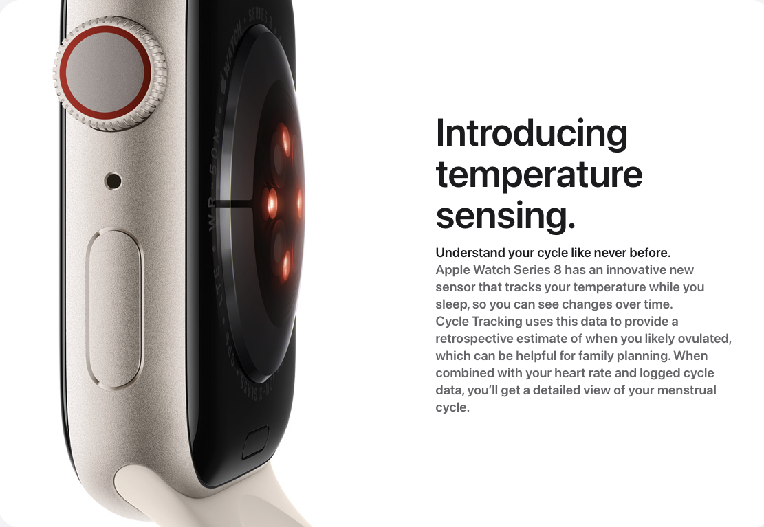
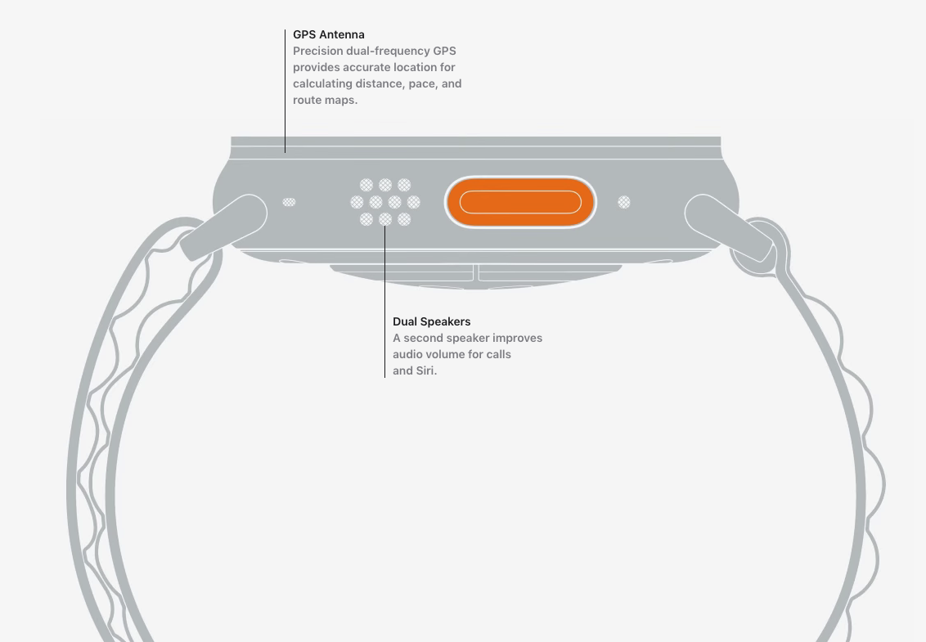
Sensors and actuators are an integral part of most consumer electronic devices
Essential part of almost all consumer electronic devices
They are an Interface of electronic devices with the physical world
Courtesy: Apple
Notes:
First, we look at the computational elements, and these consist of a microcontroller or an FPGA. Today, we find that these computational elements consume at least one order of magnitude higher power consumption when compared to the commonly used sensors.
However, we also find that microcontrollers are increasingly becoming energy efficient. We investigate a typical microcontroller that has been used in sensor platforms over the past two decades. We find that energy efficiency has improved by almost two orders of magnitude. Some of the present-generation microcontrollers, such as Ambiq Apollo4 consume just 3 uA/MHz than 330 uA for MSP430 used on platforms such as TelOS B.
If the trend continues, we can expect the microcontrollers to catch up with the sensors and become energy-efficient. This significant improvement is that the digital components are increasing becoming efficient as they follow moore’s law.

Slide 52
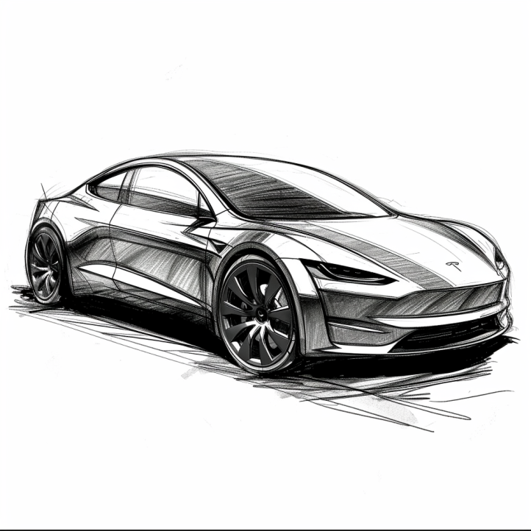
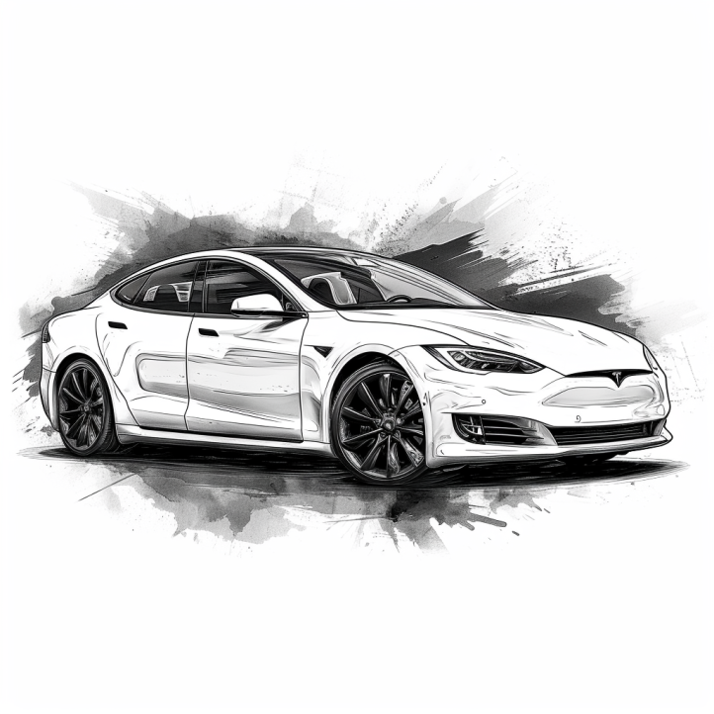
Cars are all software and sensors
Electric cars have numerous sensors and microcontrollers
Various sensors that are used in cars include:
Tracking location: GPS (global positioning system)
Distance measurement: Ultrasonic sensors
Terrain mapping: Lidar (light detection and ranging)
Proximity sensing: radar
Various forms of cameras
Motion sensor: accelerometers
…. And many more
Notes:
First, we look at the computational elements, and these consist of a microcontroller or an FPGA. Today, we find that these computational elements consume at least one order of magnitude higher power consumption when compared to the commonly used sensors.
However, we also find that microcontrollers are increasingly becoming energy efficient. We investigate a typical microcontroller that has been used in sensor platforms over the past two decades. We find that energy efficiency has improved by almost two orders of magnitude. Some of the present-generation microcontrollers, such as Ambiq Apollo4 consume just 3 uA/MHz than 330 uA for MSP430 used on platforms such as TelOS B.
If the trend continues, we can expect the microcontrollers to catch up with the sensors and become energy-efficient. This significant improvement is that the digital components are increasing becoming efficient as they follow moore’s law.

Slide 53
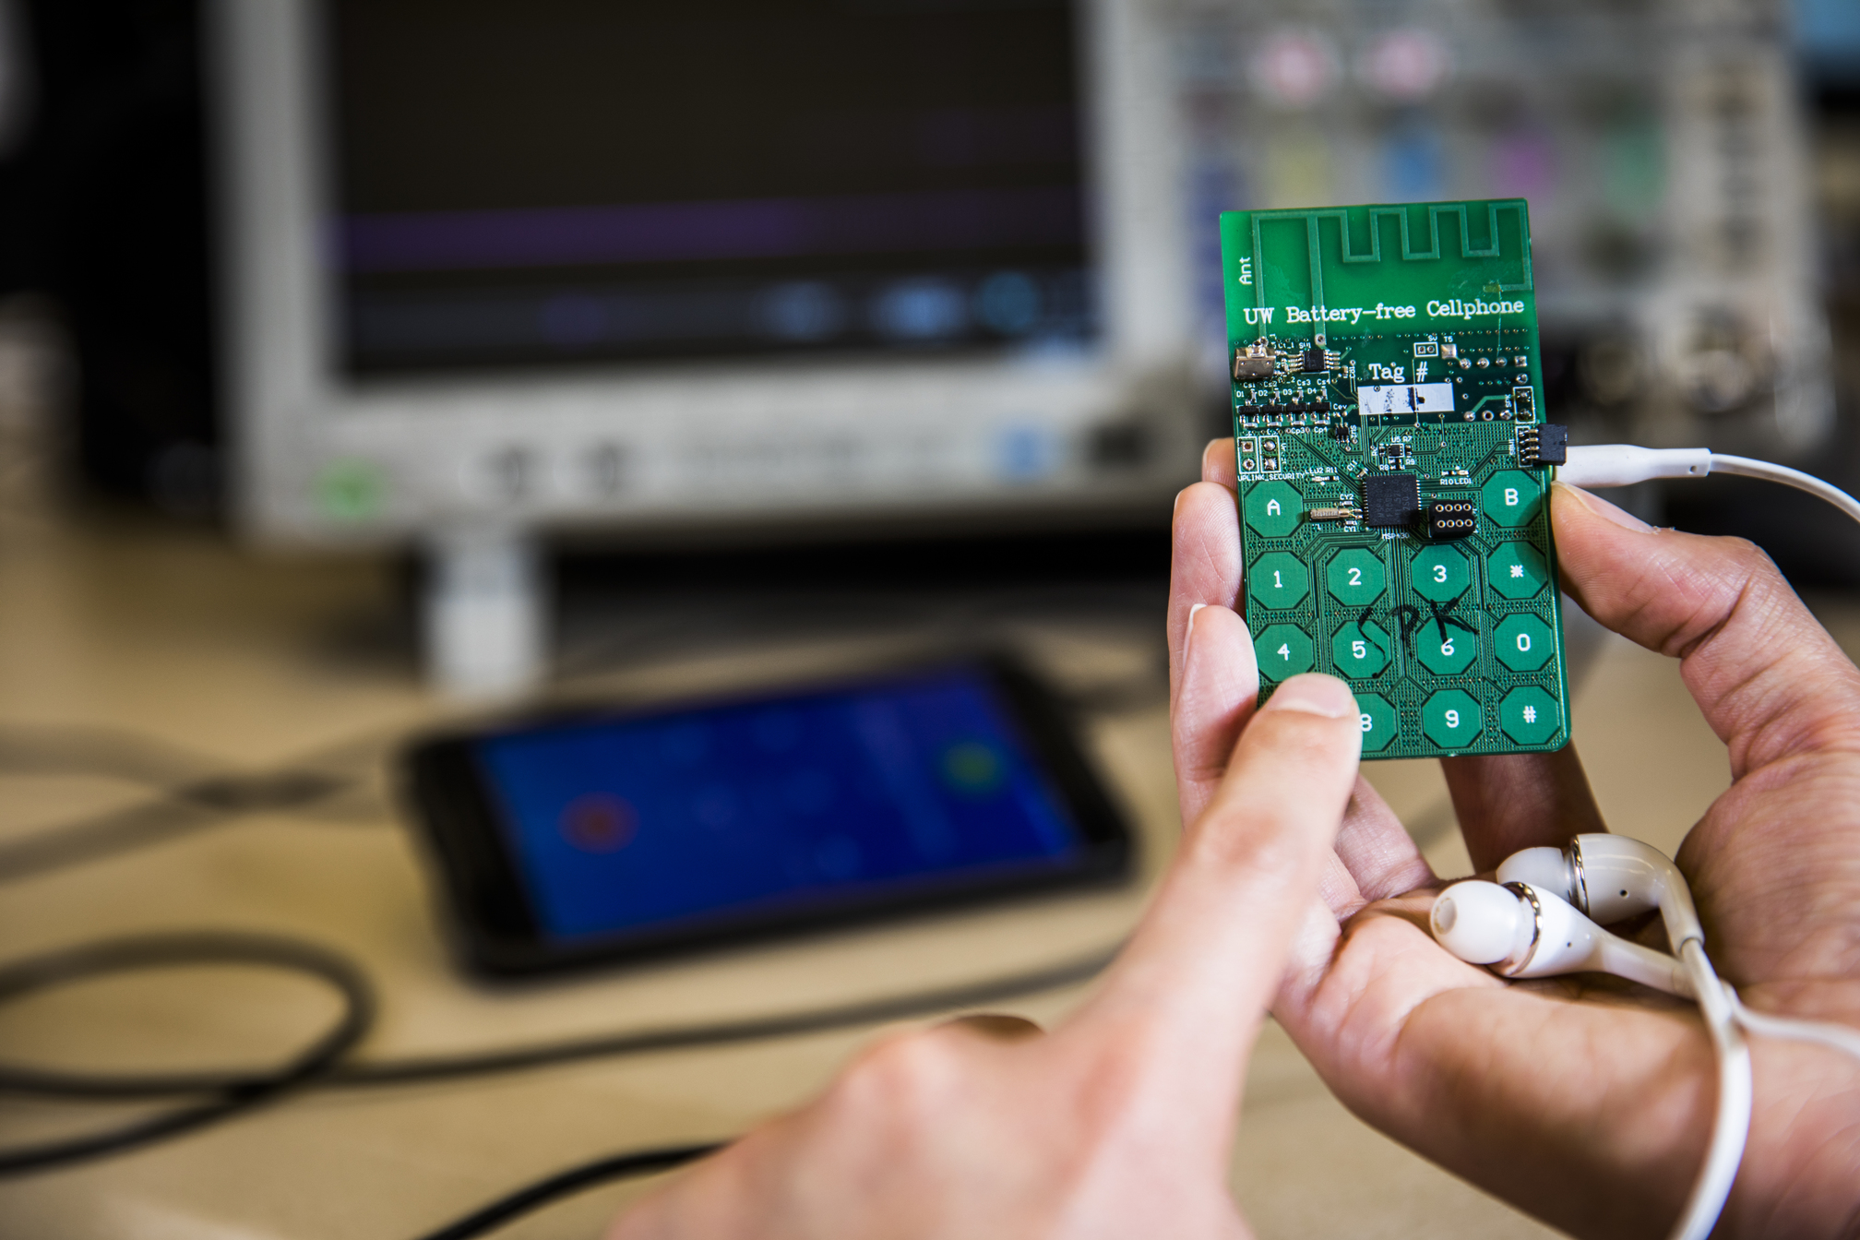
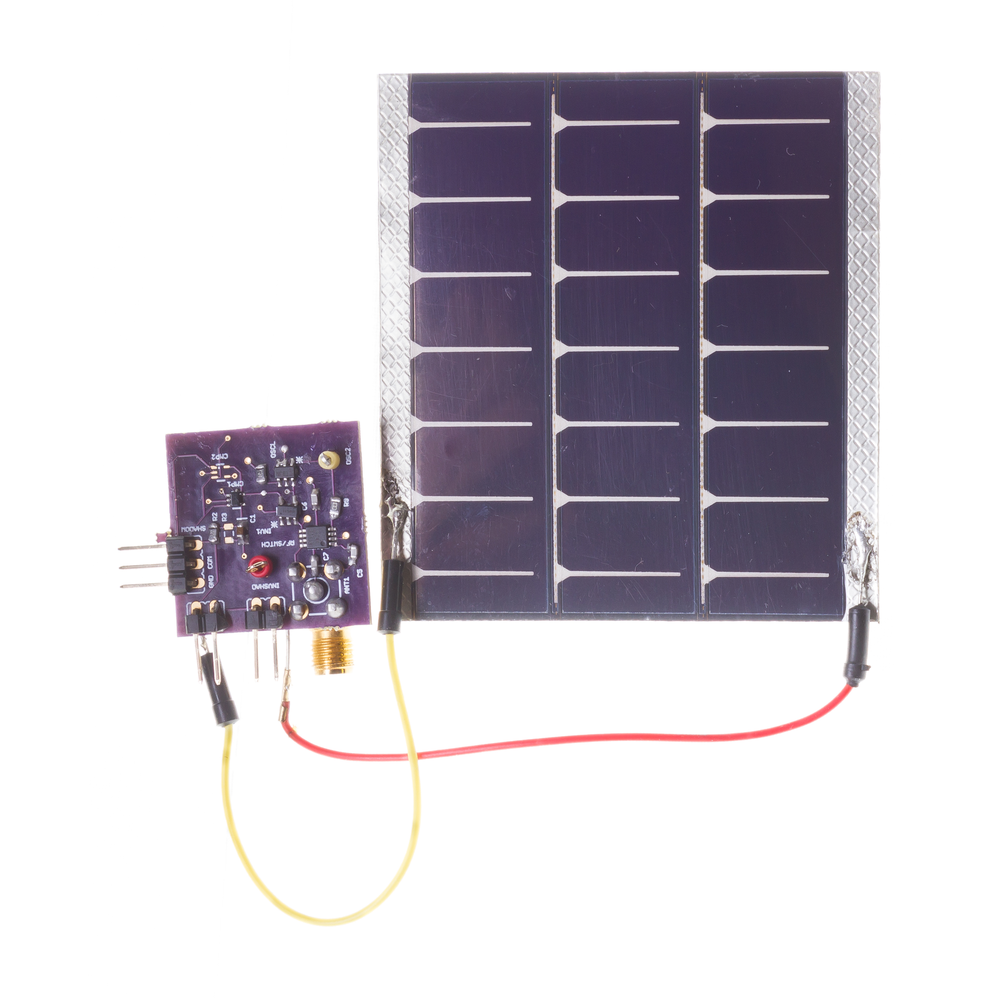
Sensors have become exceedingly energy-efficient
During past decades, sensors have become exceedingly energy-efficient
E.g., Accelerometer, Temperature, Image Sensors: Few µW’s of power
Mostly passive sensors in constrained wireless embedded devices

Slide 54
So, what are sensors ?
They are an eyes and ears for an embedded device. They sense environment and help to understand the physical world. Sensor is an electronic component that measures a physical phenomenon.
What are the phenomenon that you would like to sense and measure?
Temperature
Humidity
Acoustic
Vital signs
…….
Choice of sensor depends on the target embedded application
Notes:
First, we look at the computational elements, and these consist of a microcontroller or an FPGA. Today, we find that these computational elements consume at least one order of magnitude higher power consumption when compared to the commonly used sensors.
However, we also find that microcontrollers are increasingly becoming energy efficient. We investigate a typical microcontroller that has been used in sensor platforms over the past two decades. We find that energy efficiency has improved by almost two orders of magnitude. Some of the present-generation microcontrollers, such as Ambiq Apollo4 consume just 3 uA/MHz than 330 uA for MSP430 used on platforms such as TelOS B.
If the trend continues, we can expect the microcontrollers to catch up with the sensors and become energy-efficient. This significant improvement is that the digital components are increasing becoming efficient as they follow moore’s law.

Slide 55
Models of Sensors
Many sensors can be modelled approximately as an affine function
f : R → R
x(t) : Physical Quantity reported by sensor at the time instance t
f(x(t)): Value reported by sensor for the particular physical quantity
Function f is linear if there exists proportionality constant a ∈ R
such that for all x(t) ∈ R, f(x(t)) = ax(t)
Notes:
First, we look at the computational elements, and these consist of a microcontroller or an FPGA. Today, we find that these computational elements consume at least one order of magnitude higher power consumption when compared to the commonly used sensors.
However, we also find that microcontrollers are increasingly becoming energy efficient. We investigate a typical microcontroller that has been used in sensor platforms over the past two decades. We find that energy efficiency has improved by almost two orders of magnitude. Some of the present-generation microcontrollers, such as Ambiq Apollo4 consume just 3 uA/MHz than 330 uA for MSP430 used on platforms such as TelOS B.
If the trend continues, we can expect the microcontrollers to catch up with the sensors and become energy-efficient. This significant improvement is that the digital components are increasing becoming efficient as they follow moore’s law.

Slide 56
Models of Sensors
Many sensors can be modelled approximately as an affine function
f is an affine function if there exists a proportionality constant
a ∈ R and a bias b ∈ R such that
f(x(t)) = ax(t) + b
Notes:
First, we look at the computational elements, and these consist of a microcontroller or an FPGA. Today, we find that these computational elements consume at least one order of magnitude higher power consumption when compared to the commonly used sensors.
However, we also find that microcontrollers are increasingly becoming energy efficient. We investigate a typical microcontroller that has been used in sensor platforms over the past two decades. We find that energy efficiency has improved by almost two orders of magnitude. Some of the present-generation microcontrollers, such as Ambiq Apollo4 consume just 3 uA/MHz than 330 uA for MSP430 used on platforms such as TelOS B.
If the trend continues, we can expect the microcontrollers to catch up with the sensors and become energy-efficient. This significant improvement is that the digital components are increasing becoming efficient as they follow moore’s law.

Slide 57
Models of Sensors
Is every linear function an affine function?
NO
Every affine function is a linear function
Interpreting of the sensor readings needs an understanding of the proportionality constant and bias in the affine function
Notes:
First, we look at the computational elements, and these consist of a microcontroller or an FPGA. Today, we find that these computational elements consume at least one order of magnitude higher power consumption when compared to the commonly used sensors.
However, we also find that microcontrollers are increasingly becoming energy efficient. We investigate a typical microcontroller that has been used in sensor platforms over the past two decades. We find that energy efficiency has improved by almost two orders of magnitude. Some of the present-generation microcontrollers, such as Ambiq Apollo4 consume just 3 uA/MHz than 330 uA for MSP430 used on platforms such as TelOS B.
If the trend continues, we can expect the microcontrollers to catch up with the sensors and become energy-efficient. This significant improvement is that the digital components are increasing becoming efficient as they follow moore’s law.

Slide 58
Models of Sensors
f(x(t)) = ax(t) + b
What does proportionality constant a represent?
Notes:
First, we look at the computational elements, and these consist of a microcontroller or an FPGA. Today, we find that these computational elements consume at least one order of magnitude higher power consumption when compared to the commonly used sensors.
However, we also find that microcontrollers are increasingly becoming energy efficient. We investigate a typical microcontroller that has been used in sensor platforms over the past two decades. We find that energy efficiency has improved by almost two orders of magnitude. Some of the present-generation microcontrollers, such as Ambiq Apollo4 consume just 3 uA/MHz than 330 uA for MSP430 used on platforms such as TelOS B.
If the trend continues, we can expect the microcontrollers to catch up with the sensors and become energy-efficient. This significant improvement is that the digital components are increasing becoming efficient as they follow moore’s law.

Slide 59
Models of Sensors
f(x(t)) = ax(t) + b
What does proportionality constant a represent?
Sensitivity of the sensor. Specifies degree to which the sensor reading changes in correspondence to the change in the physical quantity
Notes:
First, we look at the computational elements, and these consist of a microcontroller or an FPGA. Today, we find that these computational elements consume at least one order of magnitude higher power consumption when compared to the commonly used sensors.
However, we also find that microcontrollers are increasingly becoming energy efficient. We investigate a typical microcontroller that has been used in sensor platforms over the past two decades. We find that energy efficiency has improved by almost two orders of magnitude. Some of the present-generation microcontrollers, such as Ambiq Apollo4 consume just 3 uA/MHz than 330 uA for MSP430 used on platforms such as TelOS B.
If the trend continues, we can expect the microcontrollers to catch up with the sensors and become energy-efficient. This significant improvement is that the digital components are increasing becoming efficient as they follow moore’s law.

Slide 60
Does affine model always hold for a sensor?
No sensor truly realizes an affine function. The range of a sensor, the set of values of a physical quantity that it can measure, is always limited
Outside that range, an affine function model is no longer valid
Example: A thermometer may have a range of −20◦ to 50◦ Celsius. Physical quantities outside this range will typically saturate, meaning that they yield a maximum or a minimum reading outside their range
Notes:
First, we look at the computational elements, and these consist of a microcontroller or an FPGA. Today, we find that these computational elements consume at least one order of magnitude higher power consumption when compared to the commonly used sensors.
However, we also find that microcontrollers are increasingly becoming energy efficient. We investigate a typical microcontroller that has been used in sensor platforms over the past two decades. We find that energy efficiency has improved by almost two orders of magnitude. Some of the present-generation microcontrollers, such as Ambiq Apollo4 consume just 3 uA/MHz than 330 uA for MSP430 used on platforms such as TelOS B.
If the trend continues, we can expect the microcontrollers to catch up with the sensors and become energy-efficient. This significant improvement is that the digital components are increasing becoming efficient as they follow moore’s law.

Slide 61
Does affine model always hold for a sensor?
No sensor truly realizes an affine function. The range of a sensor, the set of values of a physical quantity that it can measure, is always limited
Outside that range, an affine function model is no longer valid
Example: A thermometer may have a range of −20◦ to 50◦ Celsius. Physical quantities outside this range will typically saturate, meaning that they yield a maximum or a minimum reading outside their range or they saturate in readings. How do we represent the sensor function?
Notes:
First, we look at the computational elements, and these consist of a microcontroller or an FPGA. Today, we find that these computational elements consume at least one order of magnitude higher power consumption when compared to the commonly used sensors.
However, we also find that microcontrollers are increasingly becoming energy efficient. We investigate a typical microcontroller that has been used in sensor platforms over the past two decades. We find that energy efficiency has improved by almost two orders of magnitude. Some of the present-generation microcontrollers, such as Ambiq Apollo4 consume just 3 uA/MHz than 330 uA for MSP430 used on platforms such as TelOS B.
If the trend continues, we can expect the microcontrollers to catch up with the sensors and become energy-efficient. This significant improvement is that the digital components are increasing becoming efficient as they follow moore’s law.

Slide 62
Does affine model always hold for a sensor?
What do you mean by saturation? What is sensor reading ?
Notes:
First, we look at the computational elements, and these consist of a microcontroller or an FPGA. Today, we find that these computational elements consume at least one order of magnitude higher power consumption when compared to the commonly used sensors.
However, we also find that microcontrollers are increasingly becoming energy efficient. We investigate a typical microcontroller that has been used in sensor platforms over the past two decades. We find that energy efficiency has improved by almost two orders of magnitude. Some of the present-generation microcontrollers, such as Ambiq Apollo4 consume just 3 uA/MHz than 330 uA for MSP430 used on platforms such as TelOS B.
If the trend continues, we can expect the microcontrollers to catch up with the sensors and become energy-efficient. This significant improvement is that the digital components are increasing becoming efficient as they follow moore’s law.

Slide 63
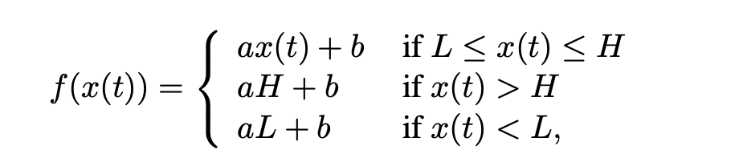
Does affine model always hold for a sensor?
What do you mean by saturation? What is sensor reading ?
Where L, H ∈ R, L < H, are the low and high end of the sensor range
Notes:
First, we look at the computational elements, and these consist of a microcontroller or an FPGA. Today, we find that these computational elements consume at least one order of magnitude higher power consumption when compared to the commonly used sensors.
However, we also find that microcontrollers are increasingly becoming energy efficient. We investigate a typical microcontroller that has been used in sensor platforms over the past two decades. We find that energy efficiency has improved by almost two orders of magnitude. Some of the present-generation microcontrollers, such as Ambiq Apollo4 consume just 3 uA/MHz than 330 uA for MSP430 used on platforms such as TelOS B.
If the trend continues, we can expect the microcontrollers to catch up with the sensors and become energy-efficient. This significant improvement is that the digital components are increasing becoming efficient as they follow moore’s law.

Slide 64
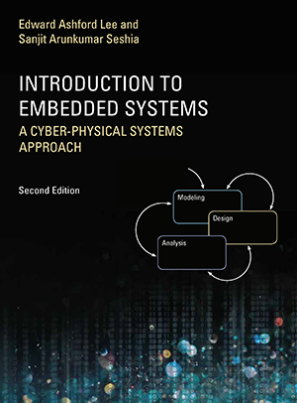
Takeaway from the discussion
An example of a simple form of nonlinearity that is shared by all sensors
The sensor is reasonably modelled by an affine function within an operating range (L, H), but outside that operating range:
behaviour of sensor is distinctly different
Many actuators are also modelled by affine function
Good reference: Introduction to Embedded Systems, Seshia and Lee
Chapter 7
Link: On Canvas
Notes:
First, we look at the computational elements, and these consist of a microcontroller or an FPGA. Today, we find that these computational elements consume at least one order of magnitude higher power consumption when compared to the commonly used sensors.
However, we also find that microcontrollers are increasingly becoming energy efficient. We investigate a typical microcontroller that has been used in sensor platforms over the past two decades. We find that energy efficiency has improved by almost two orders of magnitude. Some of the present-generation microcontrollers, such as Ambiq Apollo4 consume just 3 uA/MHz than 330 uA for MSP430 used on platforms such as TelOS B.
If the trend continues, we can expect the microcontrollers to catch up with the sensors and become energy-efficient. This significant improvement is that the digital components are increasing becoming efficient as they follow moore’s law.

Slide 65
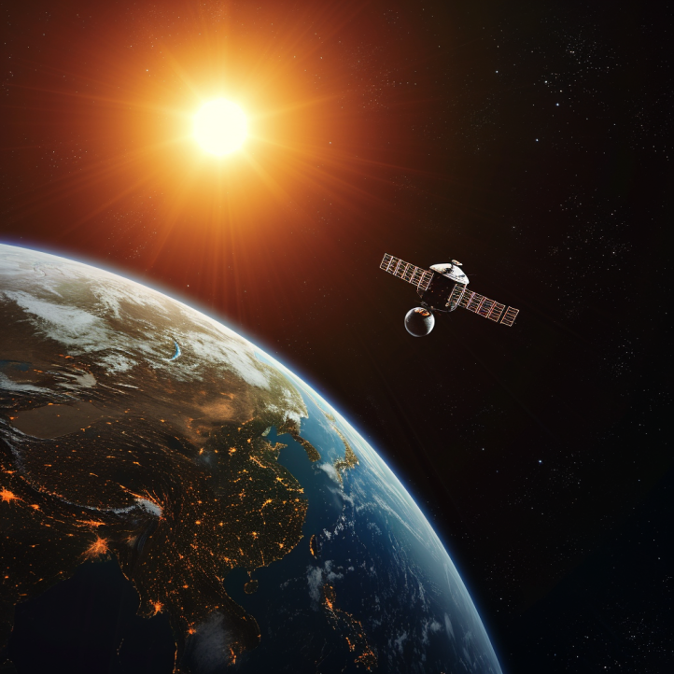
Different forms of sensing: Active vs Passive
Passive Sensing
Active Sensing

Slide 66
Different forms of sensing: Active vs Passive
Passive Sensing
Active Sensing
When we talk about embedded systems we focus on passive sensing. As It is much cheaper and at a lower energy consumption

Slide 67
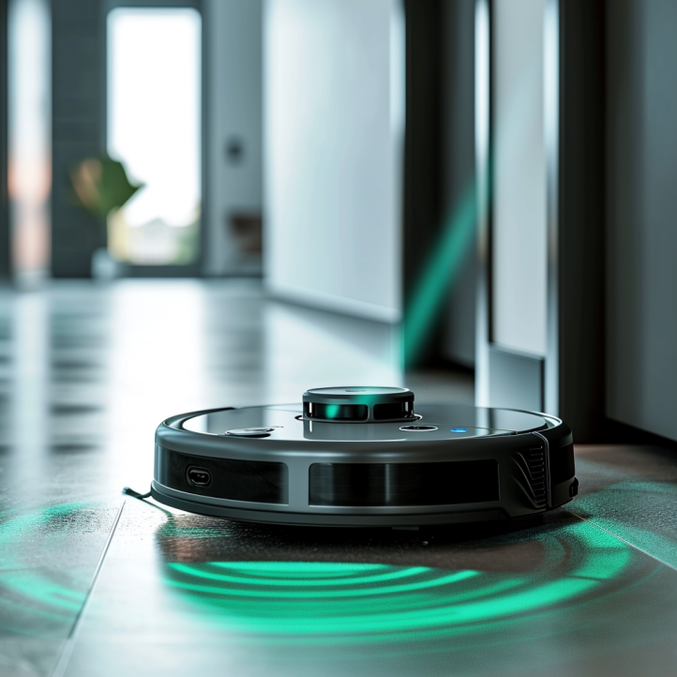
Identify passive/active sensing from applications?
Vacuum cleaners: Distance measurement using ultrasound and Lidar

Slide 68
Identify passive/active sensing from applications?
Vacuum cleaners: Distance measurement using ultrasound and Lidar
Active: Transmit acoustic signal (ultrasound) or laser (Lidar)

Slide 69

Identify passive/active sensing from applications?
Taking photographs under camera flash

Slide 70
Identify passive/active sensing from applications?
Taking photographs under camera flash: active sensing

Slide 71
Identify passive/active sensing from applications?
Taking photographs without camera flash: passive sensing

Slide 72
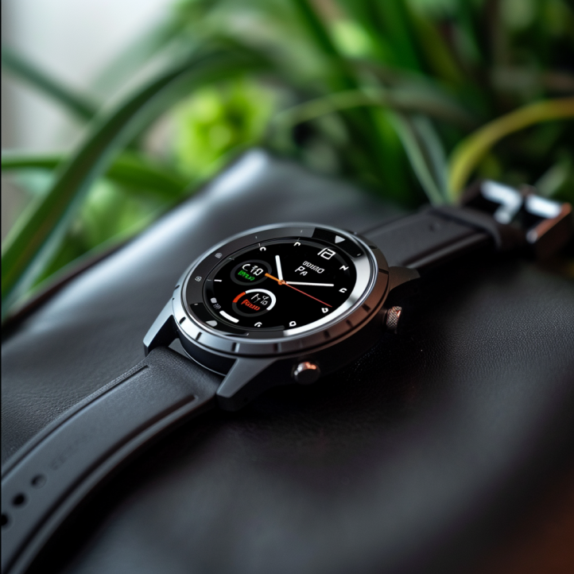
Identify passive/active sensing from applications?
Body temperature sensing on a smart watch?

Slide 73
Identify passive/active sensing from applications?
Body temperature sensing on a smartwatch? Passive sensing

Slide 74
Sensors transform phenomenon into electrical signals
How sensors convert physical phenomena into electrical signals, we refer to Ohm's Law, which states that Voltage (V) equals Current (I) times Resistance (R)
V (Voltage) = I (Current) X R (Resistance)
By altering one of the variables in Ohm’s law —Voltage (V), Current (I), or Resistance (R)—in response to changes in the phenomenon, a sensor generates an analog electrical signal that corresponds to that phenomenon

Slide 75
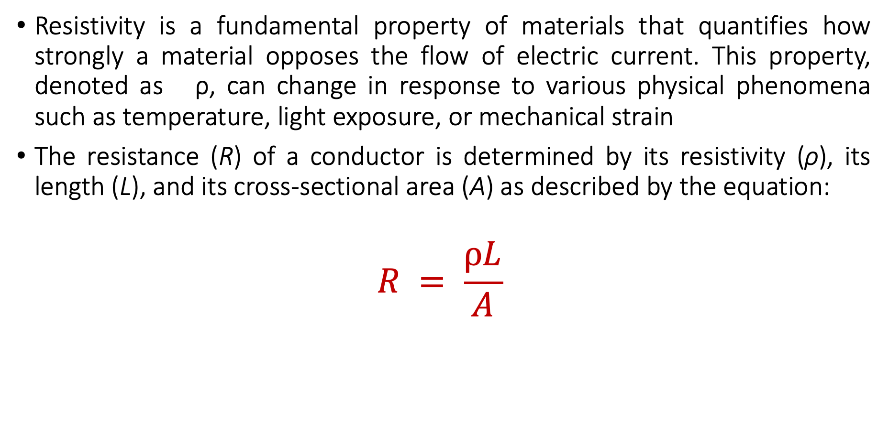
Material Resistivity and its Role in Sensing Phenomena
Resistivity is a fundamental property of materials that quantifies how strongly a material opposes the flow of electric current. This property, denoted as ρ, can change in response to various physical phenomena such as temperature, light exposure, or mechanical strain
The resistance (R) of a conductor is determined by its resistivity (ρ), its length (L), and its cross-sectional area (A) as described by the equation:
$$R = \frac{ρL}{A}$$

Slide 76
Material Resistivity and its Role in Sensing Phenomena
Resistivity (ρ): Materials with higher resistivity create more resistance for the same length and area. Resistivity is sensitive to physical conditions;
Temperature: Many conductors have higher resistivity at higher temperatures.
Light: Some materials (like photoresistors) change their resistivity exposed to light.
Strain: Materials known as strain gauges increase in resistivity when stretched.

Slide 77
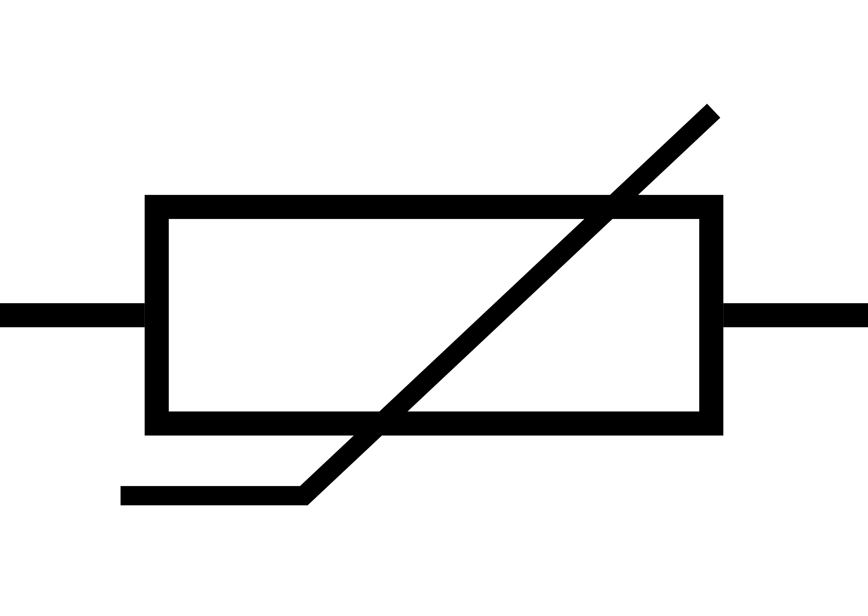
Temperature sensing using resistivity changes
Thermistor is a sensor which varies in resistance based on temperature
Advantages: They are cheap and easy to use. Low cost
Disadvantages: They have a non-linear transfer function

Slide 78
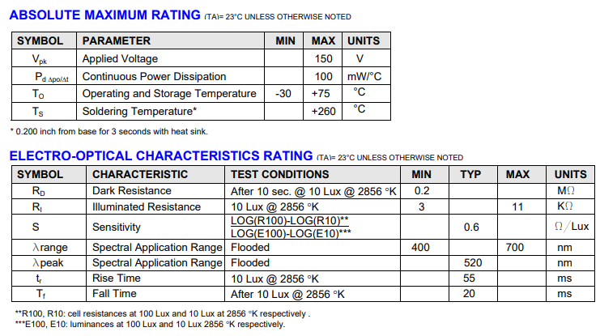
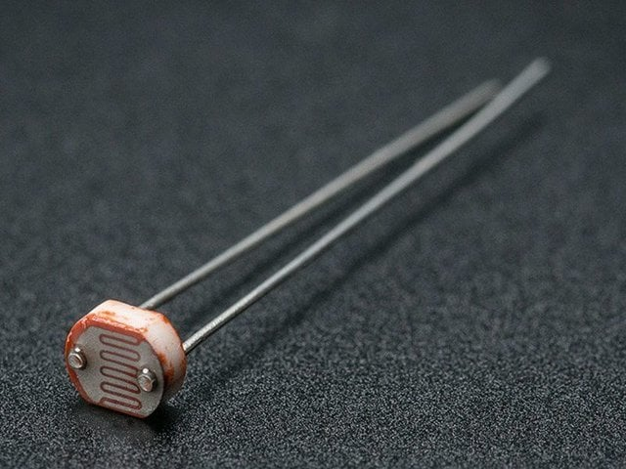
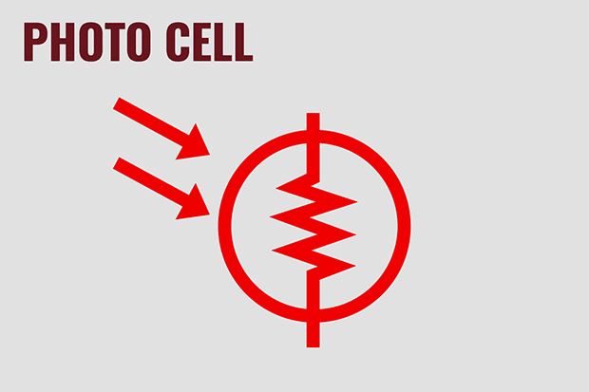
Light sensing using resistive changes
Photocell changes resistance with light (non-linear)
Example:
10 kΩ when dark
1 kΩ when light

Slide 79
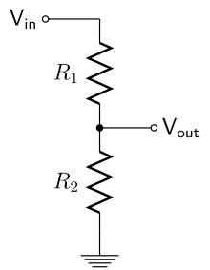
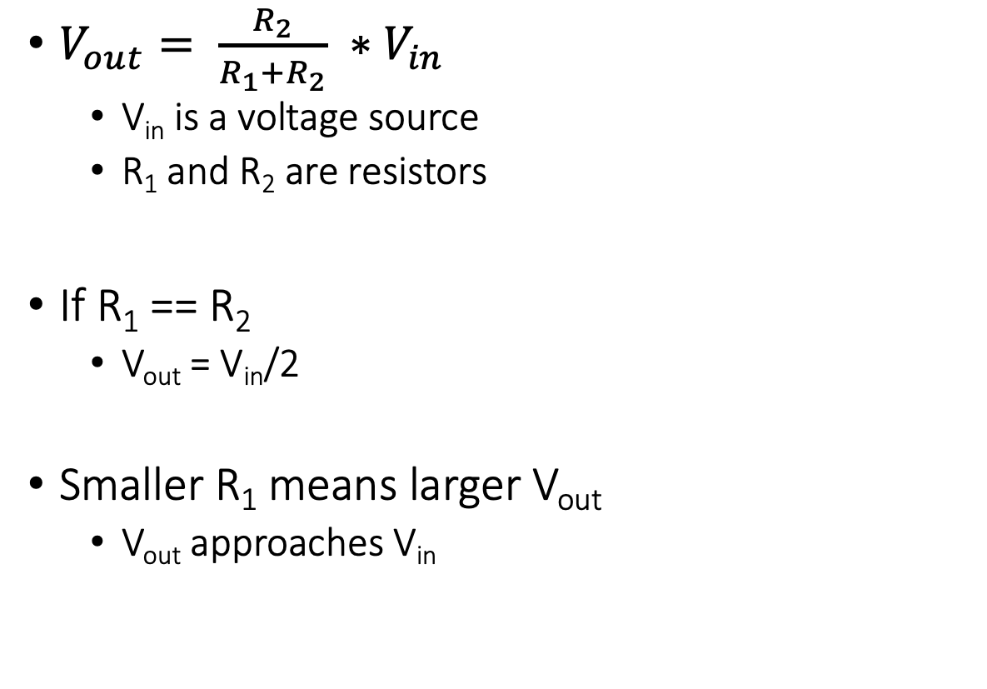
Let us go back to electronics basics: voltage dividers
$V_{out}= \frac{R_{2}}{R_{1}+R_{2}} ∗V_{in}$
V_{in} is a voltage source
R₁ and R₂ are resistors
If R₁ == R₂
V_{out} = V_{in}/2
Smaller R₁ means larger V_{out}
V_{out} approaches V_{in}

Slide 80
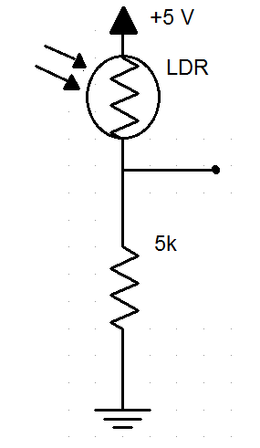
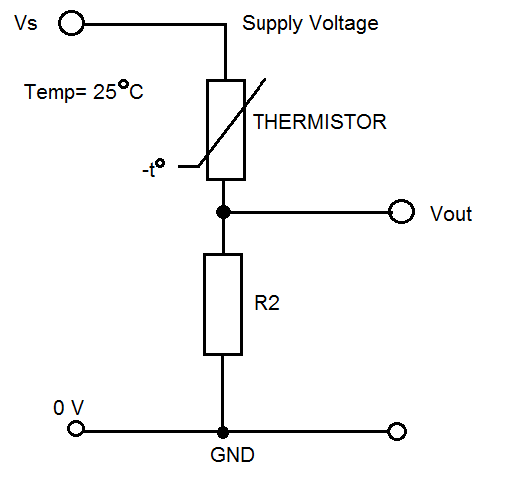
How do we measure a resistive sensor?
Place in series with resistor
Between VCC and ground
Measure voltage between the two relative to ground
Forms a “voltage divider”

Slide 81
Taking a step back: Microcontrollers are digital
Up to this point, we have talked about translating physical phenomenon to analog electrical signal changes
How do we convert the analog signal into digital?
Do we need to do any processing before the conversion operation?
Notes:
Why do the IoT platforms suffer from this energy challenge? To understand this, we investigate the architecture of the IoT device. We show this architecture in the figure on the slide. It consists of a series of stages that enable us to sense physical phenomena, process and transmit the sensor information through a transceiver such as ZigBee/BLE/LoRa.
This architecture has remained unchanged over the past two decades. We find that during this time, sensors have become exceeding efficient. Today, we find sensors such as an accelerometer or a temperature sensor consumes just a few tens of microwatts of power consumption. However, we find that rest of the architecture components that are shown in red colour remain significantly energy expensive. To understand the reason for this significant energy asymmetry, we look at the following slide.

Slide 82
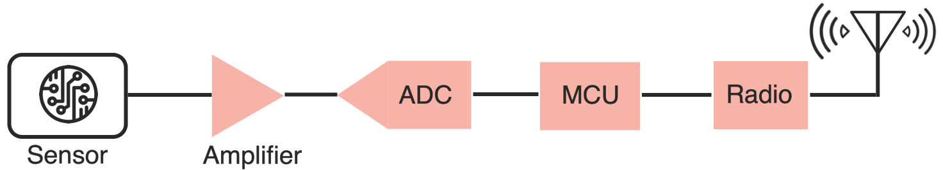
Taking a step back: Microcontrollers are digital
Up to this point, we have talked about translating physical phenomenon to analog electrical signal changes
How do we convert the analog signal into digital?
Do we need to do any processing before the conversion operation?
Conventional and widely used architecture of embedded wireless platform
Notes:
Why do the IoT platforms suffer from this energy challenge? To understand this, we investigate the architecture of the IoT device. We show this architecture in the figure on the slide. It consists of a series of stages that enable us to sense physical phenomena, process and transmit the sensor information through a transceiver such as ZigBee/BLE/LoRa.
This architecture has remained unchanged over the past two decades. We find that during this time, sensors have become exceeding efficient. Today, we find sensors such as an accelerometer or a temperature sensor consumes just a few tens of microwatts of power consumption. However, we find that rest of the architecture components that are shown in red colour remain significantly energy expensive. To understand the reason for this significant energy asymmetry, we look at the following slide.

Slide 83
ADC: Bridging the analog and digital worlds
ADCs convert analog signals, which have a continuous range of values, into digital signals, which have discrete numerical representations. This is essential for digital devices to process real-world analog inputs
What are the various parameters of the ADC?
Resolution: Determined by the number of bits the ADC uses to represent the analog value. More bits mean higher resolution and finer granularity in the output
Sampling Rate: The frequency at which the ADC samples the analog signal. Higher sampling rates can capture more detail and are necessary to comply with the Nyquist theorem. It also means higher power consumption
Accuracy: The closeness of the ADC's output to the true input value. It includes factors such as linearity, noise, and error rate
Notes:
Why do the IoT platforms suffer from this energy challenge? To understand this, we investigate the architecture of the IoT device. We show this architecture in the figure on the slide. It consists of a series of stages that enable us to sense physical phenomena, process and transmit the sensor information through a transceiver such as ZigBee/BLE/LoRa.
This architecture has remained unchanged over the past two decades. We find that during this time, sensors have become exceeding efficient. Today, we find sensors such as an accelerometer or a temperature sensor consumes just a few tens of microwatts of power consumption. However, we find that rest of the architecture components that are shown in red colour remain significantly energy expensive. To understand the reason for this significant energy asymmetry, we look at the following slide.

Slide 84
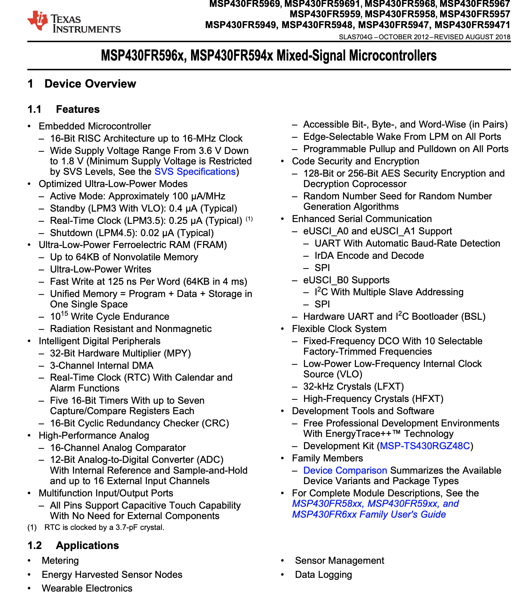

ADC: Bridging the analog and digital worlds
Notes:
Why do the IoT platforms suffer from this energy challenge? To understand this, we investigate the architecture of the IoT device. We show this architecture in the figure on the slide. It consists of a series of stages that enable us to sense physical phenomena, process and transmit the sensor information through a transceiver such as ZigBee/BLE/LoRa.
This architecture has remained unchanged over the past two decades. We find that during this time, sensors have become exceeding efficient. Today, we find sensors such as an accelerometer or a temperature sensor consumes just a few tens of microwatts of power consumption. However, we find that rest of the architecture components that are shown in red colour remain significantly energy expensive. To understand the reason for this significant energy asymmetry, we look at the following slide.

Slide 85
Digital Sensors
Some sensors incorporate ADC within their circuits to provide digitized signal which then can be read by a microcontroller
Dynamic Range: Digital sensors are unable to distinguish between two closely-spaced values of the physical quantity. The precision p of a sensor is the smallest absolute difference between two values of a physical quantity whose sensor readings are distinguishable

Slide 86

Dynamic Range of Digital Sensors
D ∈ R+ of a digital sensor is the ratio
p = Represents the precision of the sensor

Slide 87
Dynamic Range of Digital Sensors
D ∈ R+ of a digital sensor is the ratio
p = Represents the precision of the sensor
Where H and L are the limits of the range in

Slide 88

Dynamic Range of Digital Sensors
Dynamic range is often expressed in the unit of decibels
How do you estimate in decibels?

Slide 89
Quantization of sensor readings
Digital sensors represent a physical quantity through a n-bit number
n is a typically a small number, how many values are there?

Slide 90
Quantization of sensor readings
Digital sensors represent a physical quantity through a n-bit number
n is a typically a small number, how many values are there? 2^{n}
Digital sensors can only produce 2^{n} distinct measurements
Actual physical quantity?

Slide 91
Quantization of sensor readings
Digital sensors represent a physical quantity through a n-bit number
n is a typically a small number, how many values are there? 2^{n}
Digital sensors can only produce 2^{n} distinct measurements
Actual physical quantity? represented by a real number x(t) ∈ R

Slide 92
Quantization of sensor readings
Digital sensors represent a physical quantity through a n-bit number
n is a typically a small number, how many values are there? 2^{n}
Digital sensors can only produce 2^{n} distinct measurements
Actual physical quantity? represented by a real number x(t) ∈ R
Digital sensor picks one of the 2^{n} distinct numbers to represent it
Thus the sensor readings are Quantized!

Slide 93
Quantization of sensor readings
Digital sensors represent a physical quantity through a n-bit number
n is a typically a small number, how many values are there? 2^{n}
Digital sensors can only produce 2^{n} distinct measurements
Actual physical quantity? represented by a real number x(t) ∈ R
Digital sensor picks one of the 2^{n} distinct numbers to represent it
Thus the sensor readings are Quantized!

Slide 94
Ideal digital sensor? What should be n and p

Slide 95
Ideal digital sensor? What should be n and p
Ideal digital sensor: two physical quantities that differ by the precision p are represented by digital quantities that differ by one bit
Precision and quantization become intertwined

Slide 96

Let us look at an example
Consider a 3-bit digital sensor that can measure a voltage between zero and one volt. Such a sensor may be modelled by the function
f : R → {0, 1, · · · , 7}

Slide 97
Let us look at an example
Consider a 3-bit digital sensor that can measure a voltage between zero and one volt. Such a sensor may be modelled by the function
f : R → {0, 1, · · · , 7}
What is L, H?

Slide 98
Let us look at an example
Consider a 3-bit digital sensor that can measure a voltage between zero and one volt. Such a sensor may be modelled by the function
f : R → {0, 1, · · · , 7}
What is L, H? 0 and 1 (Volts)
What is precision?

Slide 99
Let us look at an example
Consider a 3-bit digital sensor that can measure a voltage between zero and one volt. Such a sensor may be modelled by the function
f : R → {0, 1, · · · , 7}
What is L, H? 0 and 1 (Volts)
What is precision? 1/8
What is the dynamic range?

Slide 100

Let us look at an example
Consider a 3-bit digital sensor that can measure a voltage between zero and one volt. Such a sensor may be modelled by the function
f : R → {0, 1, · · · , 7}
What is L, H? 0 and 1 (Volts)
What is precision? 1/8
What is the dynamic range?

Slide 101
Sensor Distortion Function
Defines the output of sensor as a function of input
f : R → {0, 1, · · · , 7}
For sensors with output similar to above (occurs often) has precision given by the following formula: p = (H − L)/2 ^{n}

Slide 102

Sensor Distortion Function
Defines the output of sensor as a function of input
f : R → {0, 1, · · · , 7}
For sensors with output similar to above (occurs often) has precision given by the following formula:
p = (H − L)/2 ^{n}

Slide 103
Sampling through analog to digital converter
Physical quantity x(t) is a function of time t
A digital sensor will sample the physical quantity at particular points in time to create a discrete signal
Uniform sampling, there is a fixed time interval T between samples;
T is called the sampling interval.
The resulting signal may be modelled as a function s: Z → R
∀ n ∈ Z, s(n) = f(x(nT)),
Physical quantity x(t) is observed only at times t = nT

Slide 104
Sampling through analog to digital converter
The resulting signal may be modelled as a function s: Z → R
∀ n ∈ Z, s(n) = f(x(nT)),
Physical quantity x(t) is observed only at times t = nT
What is sampling rate? 1/T
What is unit of sampling rate? Samples/second given has Hz

Slide 105
How are all of these related to ADCs?
The smaller the sampling interval T, the more costly it becomes to provide more bits in an ADC.
At the same cost, faster ADCs typically produce fewer bits and hence have either higher quantization error or smaller range
How do you decide?

Slide 106

Light sensing: Photodiodes
Most common type of light sensing mechanism
When voltage is applied in reverse to an ideal diode, no current flows
But some small amount of current leaks for real-world photo diodes
Proportional to light levels!

Slide 107

Battery-free Visible Light Sensing

Slide 108

Visible Light Marker Schematic
Light sensing
Digitisation
Communication without processing

Slide 109
Comparators represent extreme form of quantization
Analog Comparator: Performs comparison of a signal value against a threshold and produces a binary value as a result
What is the sensor function?

Slide 110
Comparators represent extreme form of quantization
Analog Comparator: Performs comparison of a signal value against a threshold and produces a binary value as a result
What is the sensor function? f : R → {0, 1}

Slide 111
Comparators represent extreme form of quantization
Analog Comparator: Performs comparison of a signal value against a threshold and produces a binary value as a result
What is the sensor function? f : R → {0, 1}
What is advantage?

Slide 112
Comparators represent extreme form of quantization
Analog Comparator: Performs comparison of a signal value against a threshold and produces a binary value as a result
What is the sensor function? f : R → {0, 1}
What is advantage? Lower power consumption. Can be directly connected to a GPIO/Pin of microcontroller (acts like a 1-bit ADC)

Slide 113
Noise in sensors and measurement
What do you mean by noise?

Slide 114
Noise in sensors and measurement
What do you mean by noise? A part of the signal which we do not want. If we want to measure x(t), and we ended up measuring x’(t) what is the noise?

Slide 115
Noise in sensors and measurement
What do you mean by noise? A part of the signal which we do not want. If we want to measure x(t), and we ended up measuring x’(t) what is the noise? n(t) = x'(t) − x(t)
What is actual measurement? X(t) + n(t)
Noise is the side effect of sensor not measuring exact;y what it is supposed to measure. Contributors many like sensor imperfection, quantization errors etc

Slide 116
How do you identify what type of sensor?
You need to learn how to read datasheets. They contain all the important information. Power, voltage, analog versus digital and others
Accelerometer: ADXL335 Datasheet
Accelerometer: ADXL345 Datasheet
Notes:
Why do the IoT platforms suffer from this energy challenge? To understand this, we investigate the architecture of the IoT device. We show this architecture in the figure on the slide. It consists of a series of stages that enable us to sense physical phenomena, process and transmit the sensor information through a transceiver such as ZigBee/BLE/LoRa.
This architecture has remained unchanged over the past two decades. We find that during this time, sensors have become exceeding efficient. Today, we find sensors such as an accelerometer or a temperature sensor consumes just a few tens of microwatts of power consumption. However, we find that rest of the architecture components that are shown in red colour remain significantly energy expensive. To understand the reason for this significant energy asymmetry, we look at the following slide.

Slide 117
Wireless Networking
Ambuj Varshney
ambujv@nus.edu.sg
Notes:
++ Thank you for inviting me to give this talk
++ In this talk, I will present a pathway that can enable us to make wireless embedded systems ubiquitous. I will describe my previous research efforts that tackle the critical challenges that limit the growth of wireless embedded systems. These are related to the growing energy asymmetry that exists between sensing, computation and communication blocks on these platforms.
++ Finally, I will conclude my talk by covering the research agenda that I would like to work on as a faculty member.

Slide 118

Motion sensing: accelerometers
Accelerometers are sensors that measure proper acceleration. An acceleration of object as observed by an observer in free fall
Accelerometer measure acceleration together with gravitational force

Slide 119
Motion sensing: accelerometers
Sensor circuit measures the position of fixed mass in the frame
Mass moves in any direction, it gets displaced, this results in displacement of mass which is measured to determine the acceleration
What happens if the object with accelerometer free-falls?

Slide 120
Motion sensing: accelerometers
What happens if the object with accelerometer free-falls?
Orientation?
Vertical, Horizontal, Upside Down
Upside down: To an observer in free fall, this looks exactly as if the assembly were accelerating upwards at the acceleration of gravity, which is approximately g = 9.8 meters/second2

Slide 121
Motion sensing: accelerometers
Accelerometer can be used to measure the tilt. Combination of acceleration and gravity is called proper acceleration and can be challenging to separate out

Slide 122

Motion sensing: accelerometers
Accelerometers usually measure in g’s
Where 1 g equals acceleration due to Earth gravity
Determining distance from acceleration is possible
But messy. Error is squared when integrating
Needs careful filtering and is only accurate over short periods
Often fills in gaps between GPS samples (or other localization systems)
Accelerometers also work as tilt sensors
Constantly sensing pull of gravity
$A[x] = 1 g ∗ sin⁡(θ)$

Slide 123
Modelling of a digital accelerometer
Assume,
x is proper acceleration
L ∈ R is the minimum measurable proper acceleration
H ∈ R is the maximum measurable proper acceleration
b ∈ N is the number of bits of the ADC
f : (L, H) → {0, . . . , 2 ^{b} − 1}

Slide 124
Measuring of acceleration on three axis
Today, accelerometer are implemented in silicon. Silicon fingers are deformed under gravitational pull or acceleration. Circuit measures the deformation
Measure three axis?

Slide 125
Measuring of acceleration on three axis
Today, accelerometer are implemented in silicon. Silicon fingers are deformed under gravitational pull or acceleration. Circuit measures the deformation
Measure three axis? Three accelerometers (different orientation) together to measure the three axis

Slide 126

Measuring position, velocity from accelerometer
Position of the object over time be p: R₊ → R, with initial position p(0)
Let the velocity of the object be v : R₊ → R, with initial velocity v(0)
Let the acceleration be x: R₊ → R.

Slide 127

Measuring rotation using gyroscope
Gyroscope help to measure rotation or change in orientation
They are not affected by gravitational field
Gyroscope are bulky rotating devices, or modern counterparts which are MEMS based leveraging optical or electromagnetic properties to detect minute changes in the orientation of the device

Slide 128

Microelectromechanical Systems (MEMS)
Mechanical structures embedded in an IC and 1 to 100 micrometers in size

Slide 129
Motion sensing: Inertial measurement unit (IMU)
IMUs (a.k.a 9 degree-of-freedom, 9DOF) track motion of a device
Acceleration (X, Y, Z axes)
Rotation (X, Y, Z axes)
Magnetism (X, Y, Z axes)
Sometimes 6DOF with Acceleration + one of the others
Intelligent sensing: combines multiple sensors, ADCs, and computation with a wired interface
9 analog inputs would otherwise be too many
Can be used to track motion, determine transportation method
Smartphones, Robotics, etc.

Slide 130

Motion sensing: Inertial measurement unit (IMU)
Courtesy: Apple

Slide 131


Other sensors: magnetic field (magnetometer)
Measures the magnetic field. Usually used in devices as a compass
Detect Earth’s magnetic field orientation
Satellites also often use magnetometers for localization
Courtesy: Adafruit

Slide 132


Active sensing: Ultrasound sensor
Emits high frequency sound waves from sensor which bounces from objects that are present in the environment
Estimates distance, proximity by measuring time taken for sounds waves to bounce back and propagate back to the ultrasound device
Power consuming, though can be used on IoT devices
Common application: Robotics, obstacle detection, water level sensing

Slide 133



Passive Infrared (PIR) sensor
Detect movement in the environment
By detecting change in IR levels
Often come with plastic lens cover to improve field of view and range

Slide 134



There are even more types of sensors
Environment: Pressure, Humidity, Air Velocity, Air Quality
Rotation: Gyroscope
Distance: Ultrasonic, Lidar, or Radar
Biometric: Pulse Oximeter, Heart Rate
Agricultural: Soil moisture

Slide 135
Wireless Networking
Ambuj Varshney
ambujv@nus.edu.sg
Notes:
++ Thank you for inviting me to give this talk
++ In this talk, I will present a pathway that can enable us to make wireless embedded systems ubiquitous. I will describe my previous research efforts that tackle the critical challenges that limit the growth of wireless embedded systems. These are related to the growing energy asymmetry that exists between sensing, computation and communication blocks on these platforms.
++ Finally, I will conclude my talk by covering the research agenda that I would like to work on as a faculty member.

